Slide 1
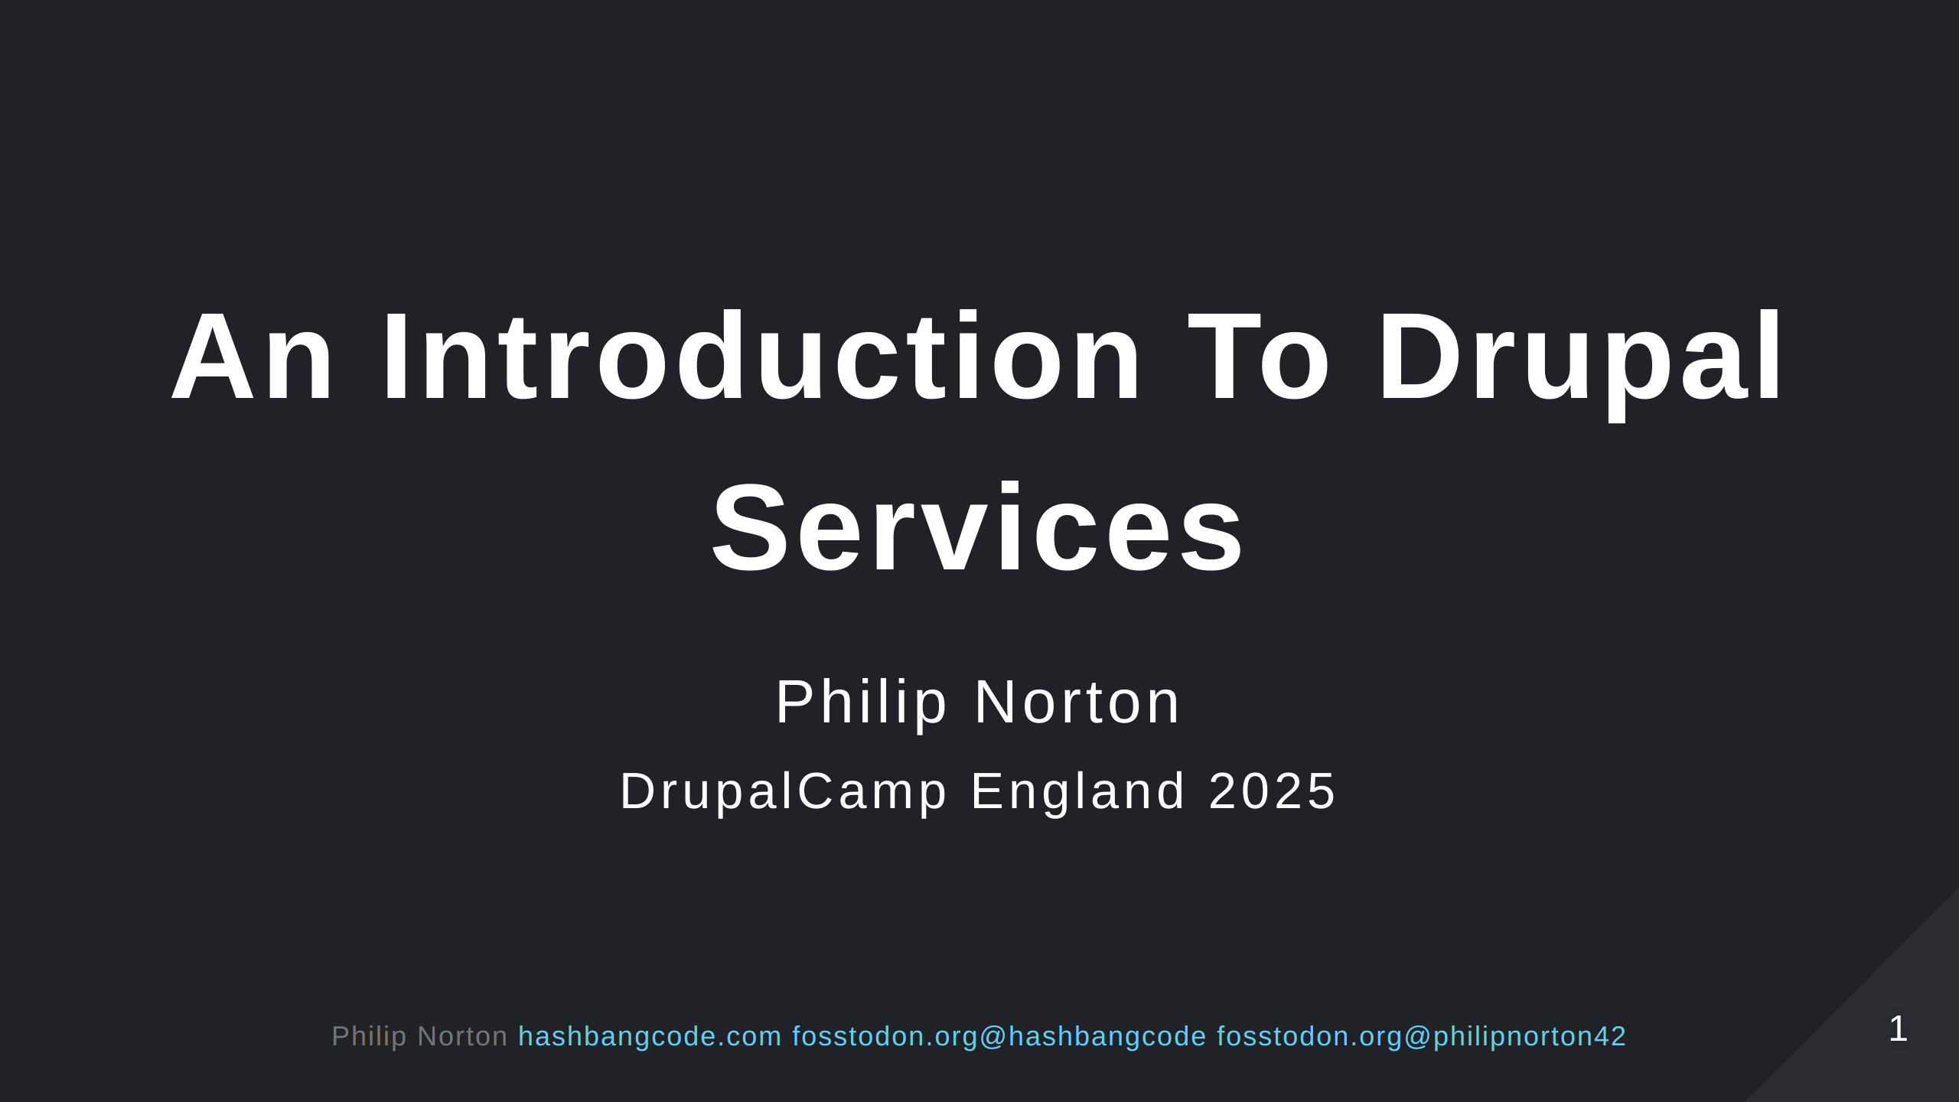

Slide 2
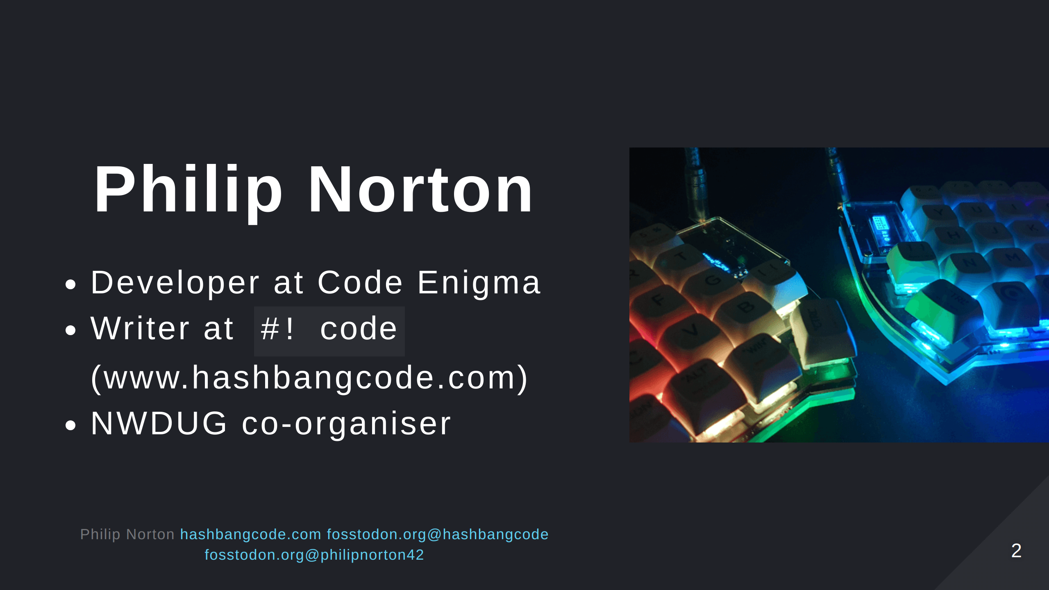
Notes:
- Doing Drupal for about 15 years. - Programming in general for about 20 now. - That is a picture of a Lily58 mechanical keyboard.

Slide 3
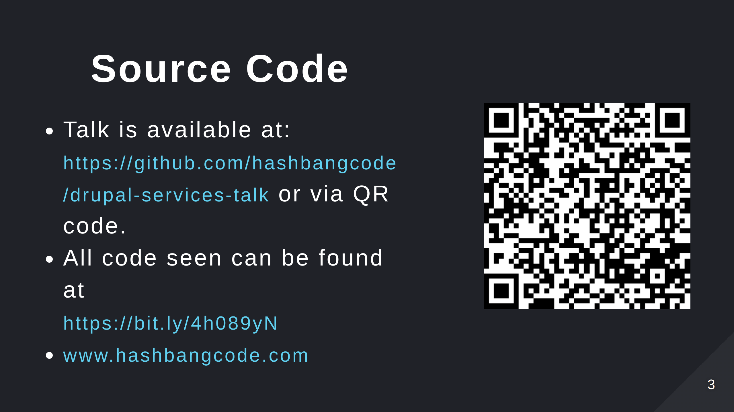
Notes:
- Scan the QR code for the talk repo. Which has links to all of the resources you need.

Slide 4
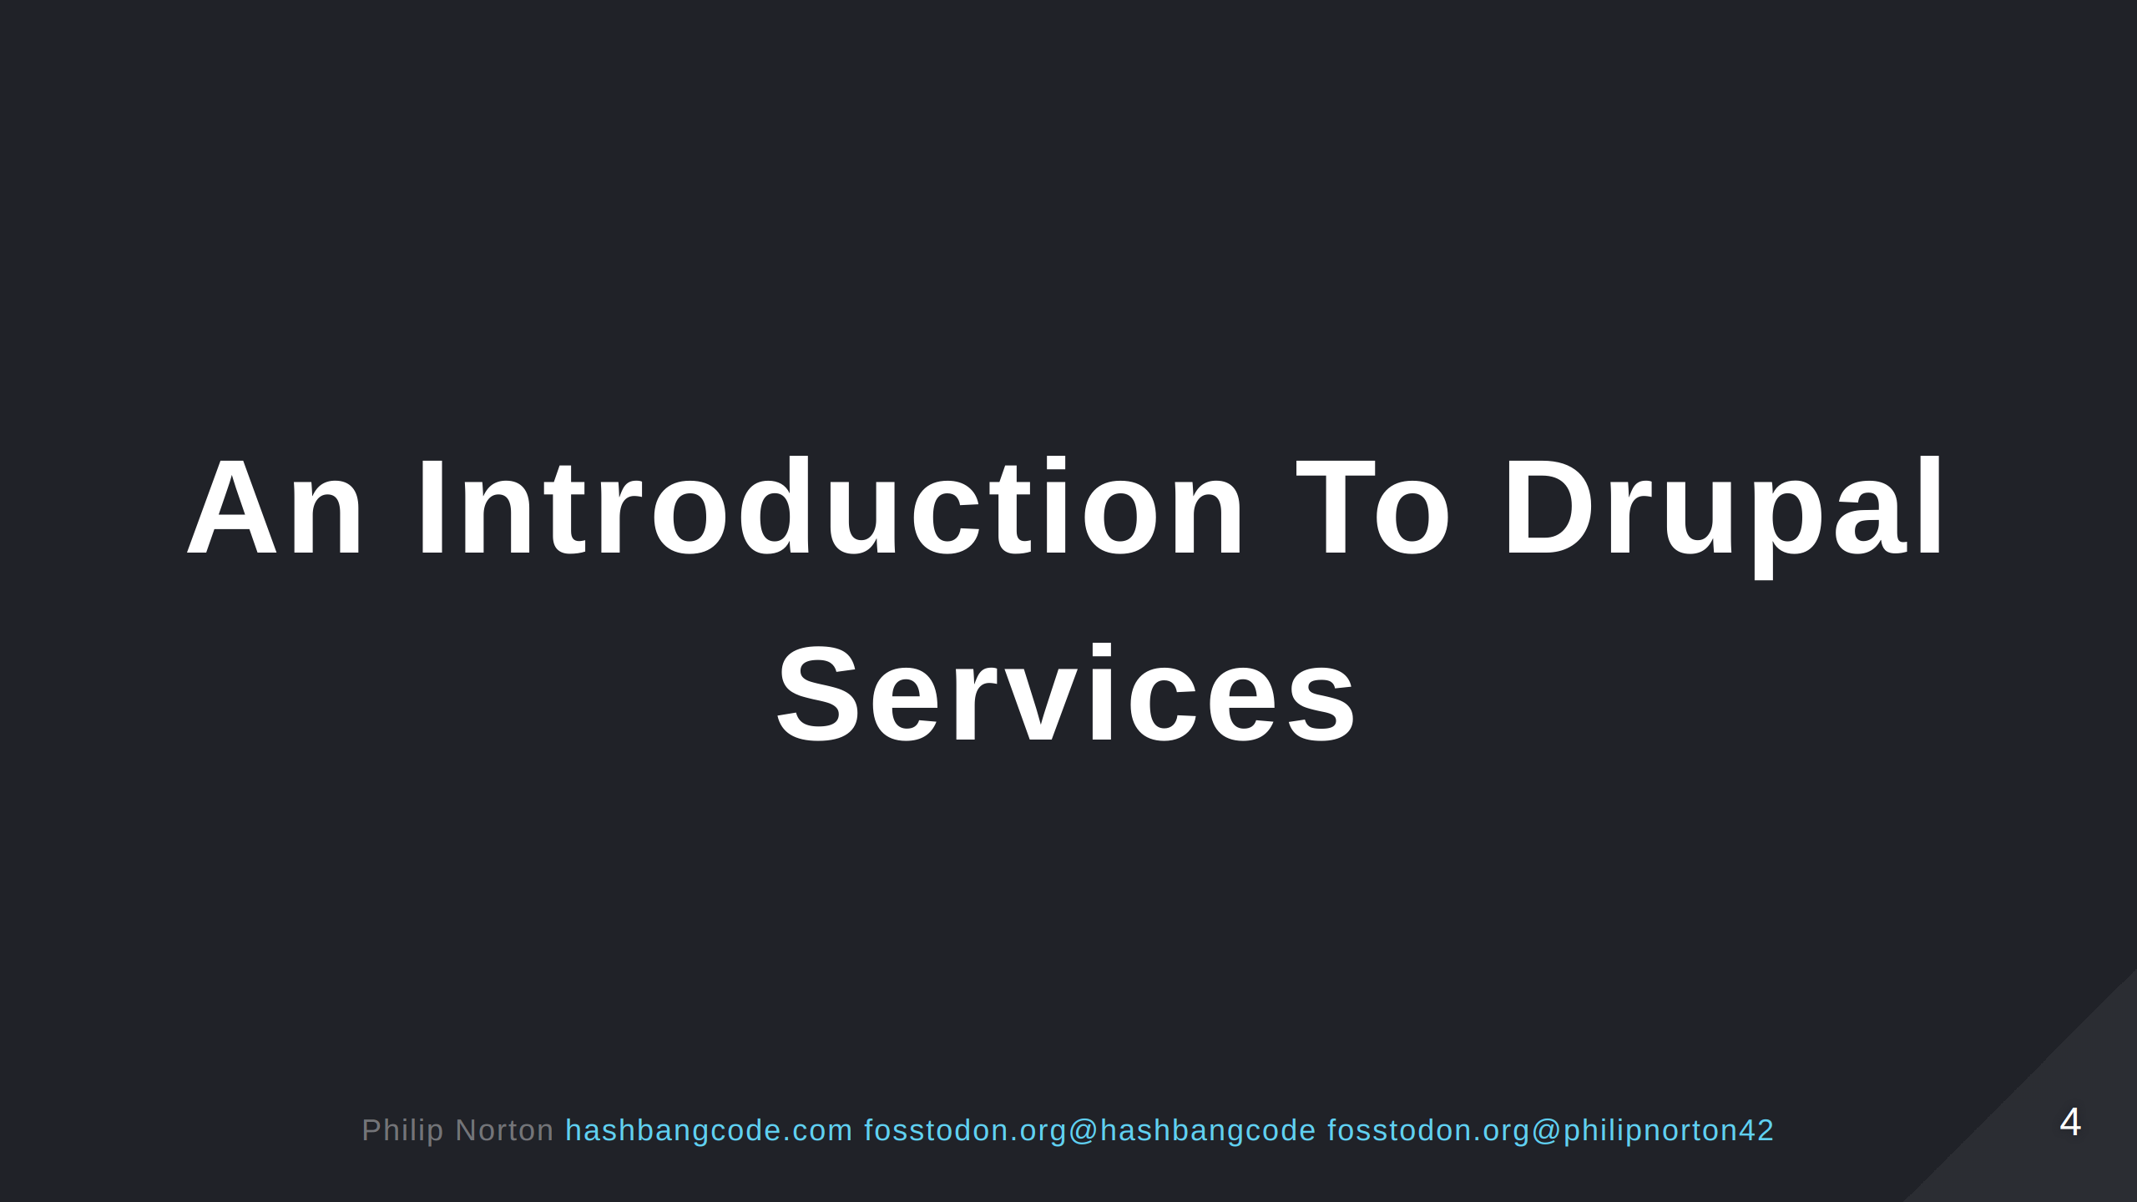
Notes:
Drupal services are an integral part of how Drupal is structured internally. Everything from connecting to a database to decoding JSON has a service you can use to do it. This talk will introduce you to what services are and how to use them. We'll talk about why they are used and then go onto building our own services. This talk will assume you have some understanding of PHP and OOP, but if you get lost then please ask me to talk you throught stuff afterwards.

Slide 5

Notes:
- I gave a version of this talk at DrupalCamp London in 2018. - A bit has changed since then so I thought it was time to an update. - They are an essential part of Drupal. - If you are going to build or maintain a module then you will use services. - I quite like back to basics talks. - Coming soon are service hooks. We will soon lose some hooks and need to use service based hooks instead.

Slide 6
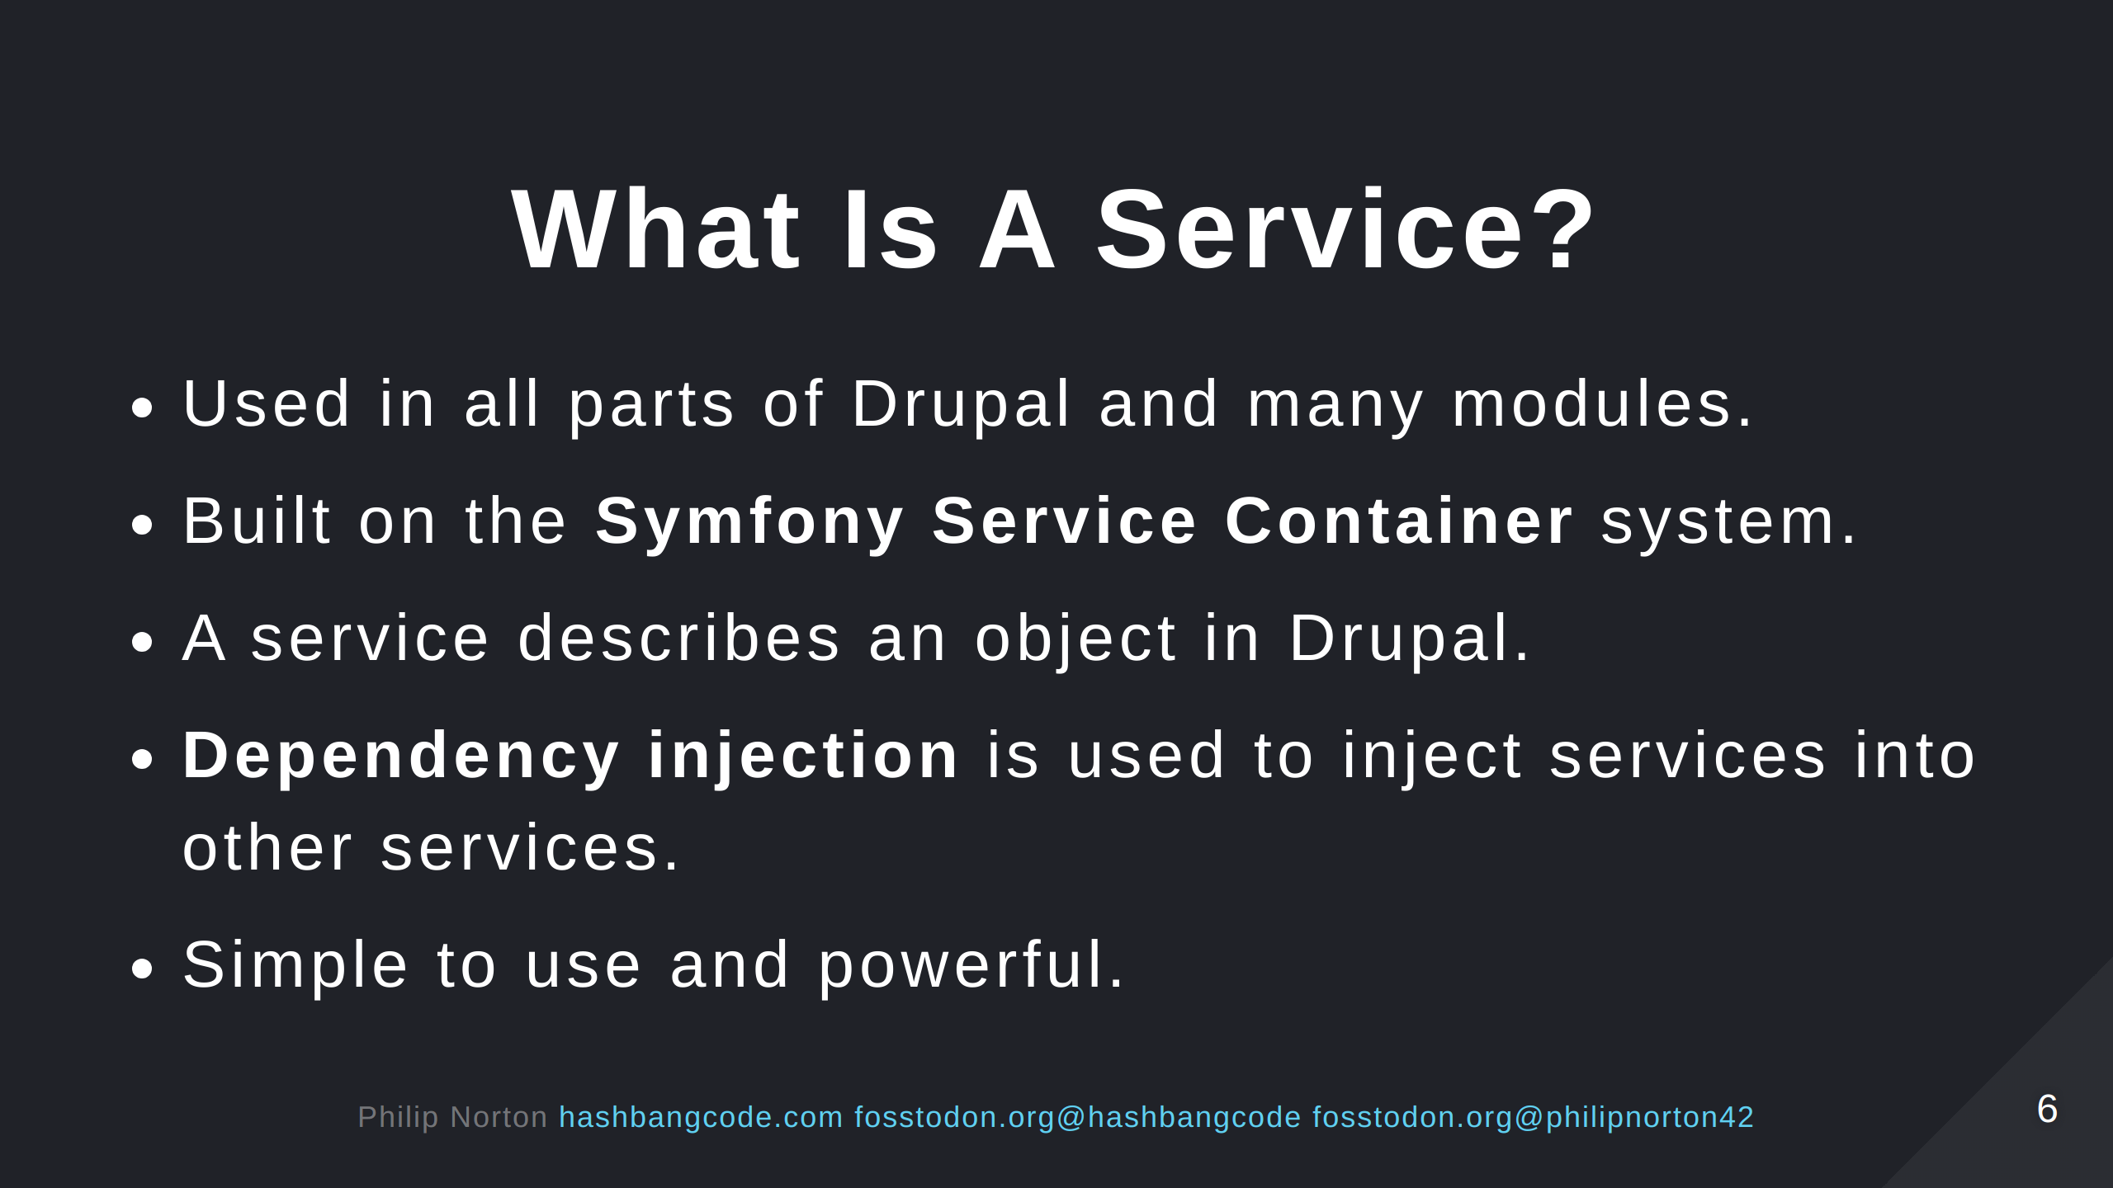

Slide 7
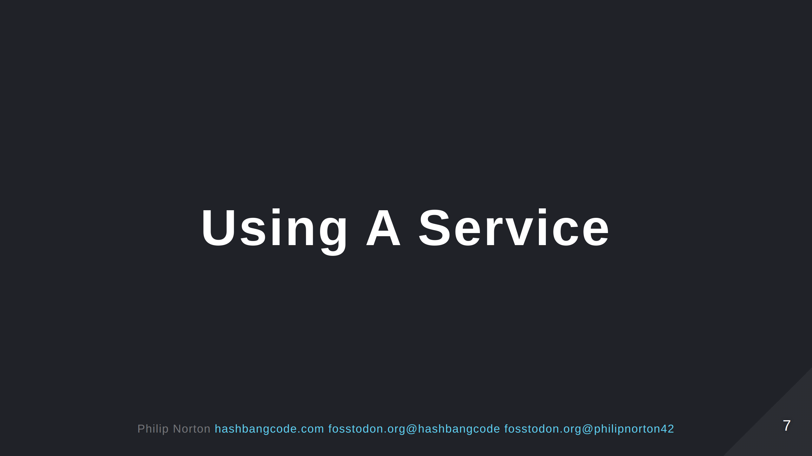

Slide 8
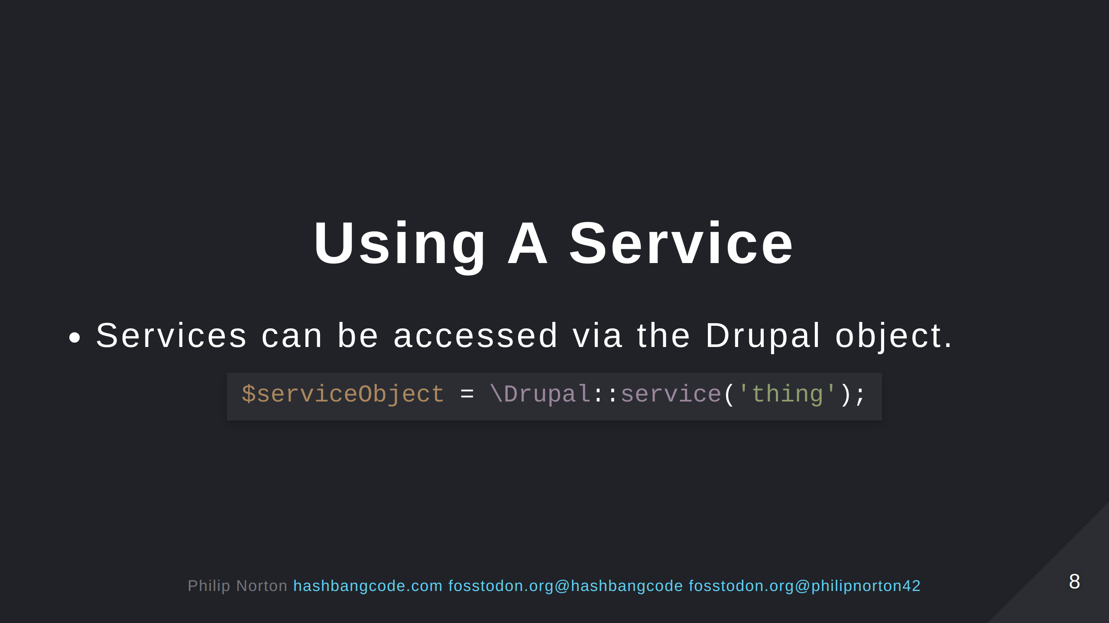

Slide 9
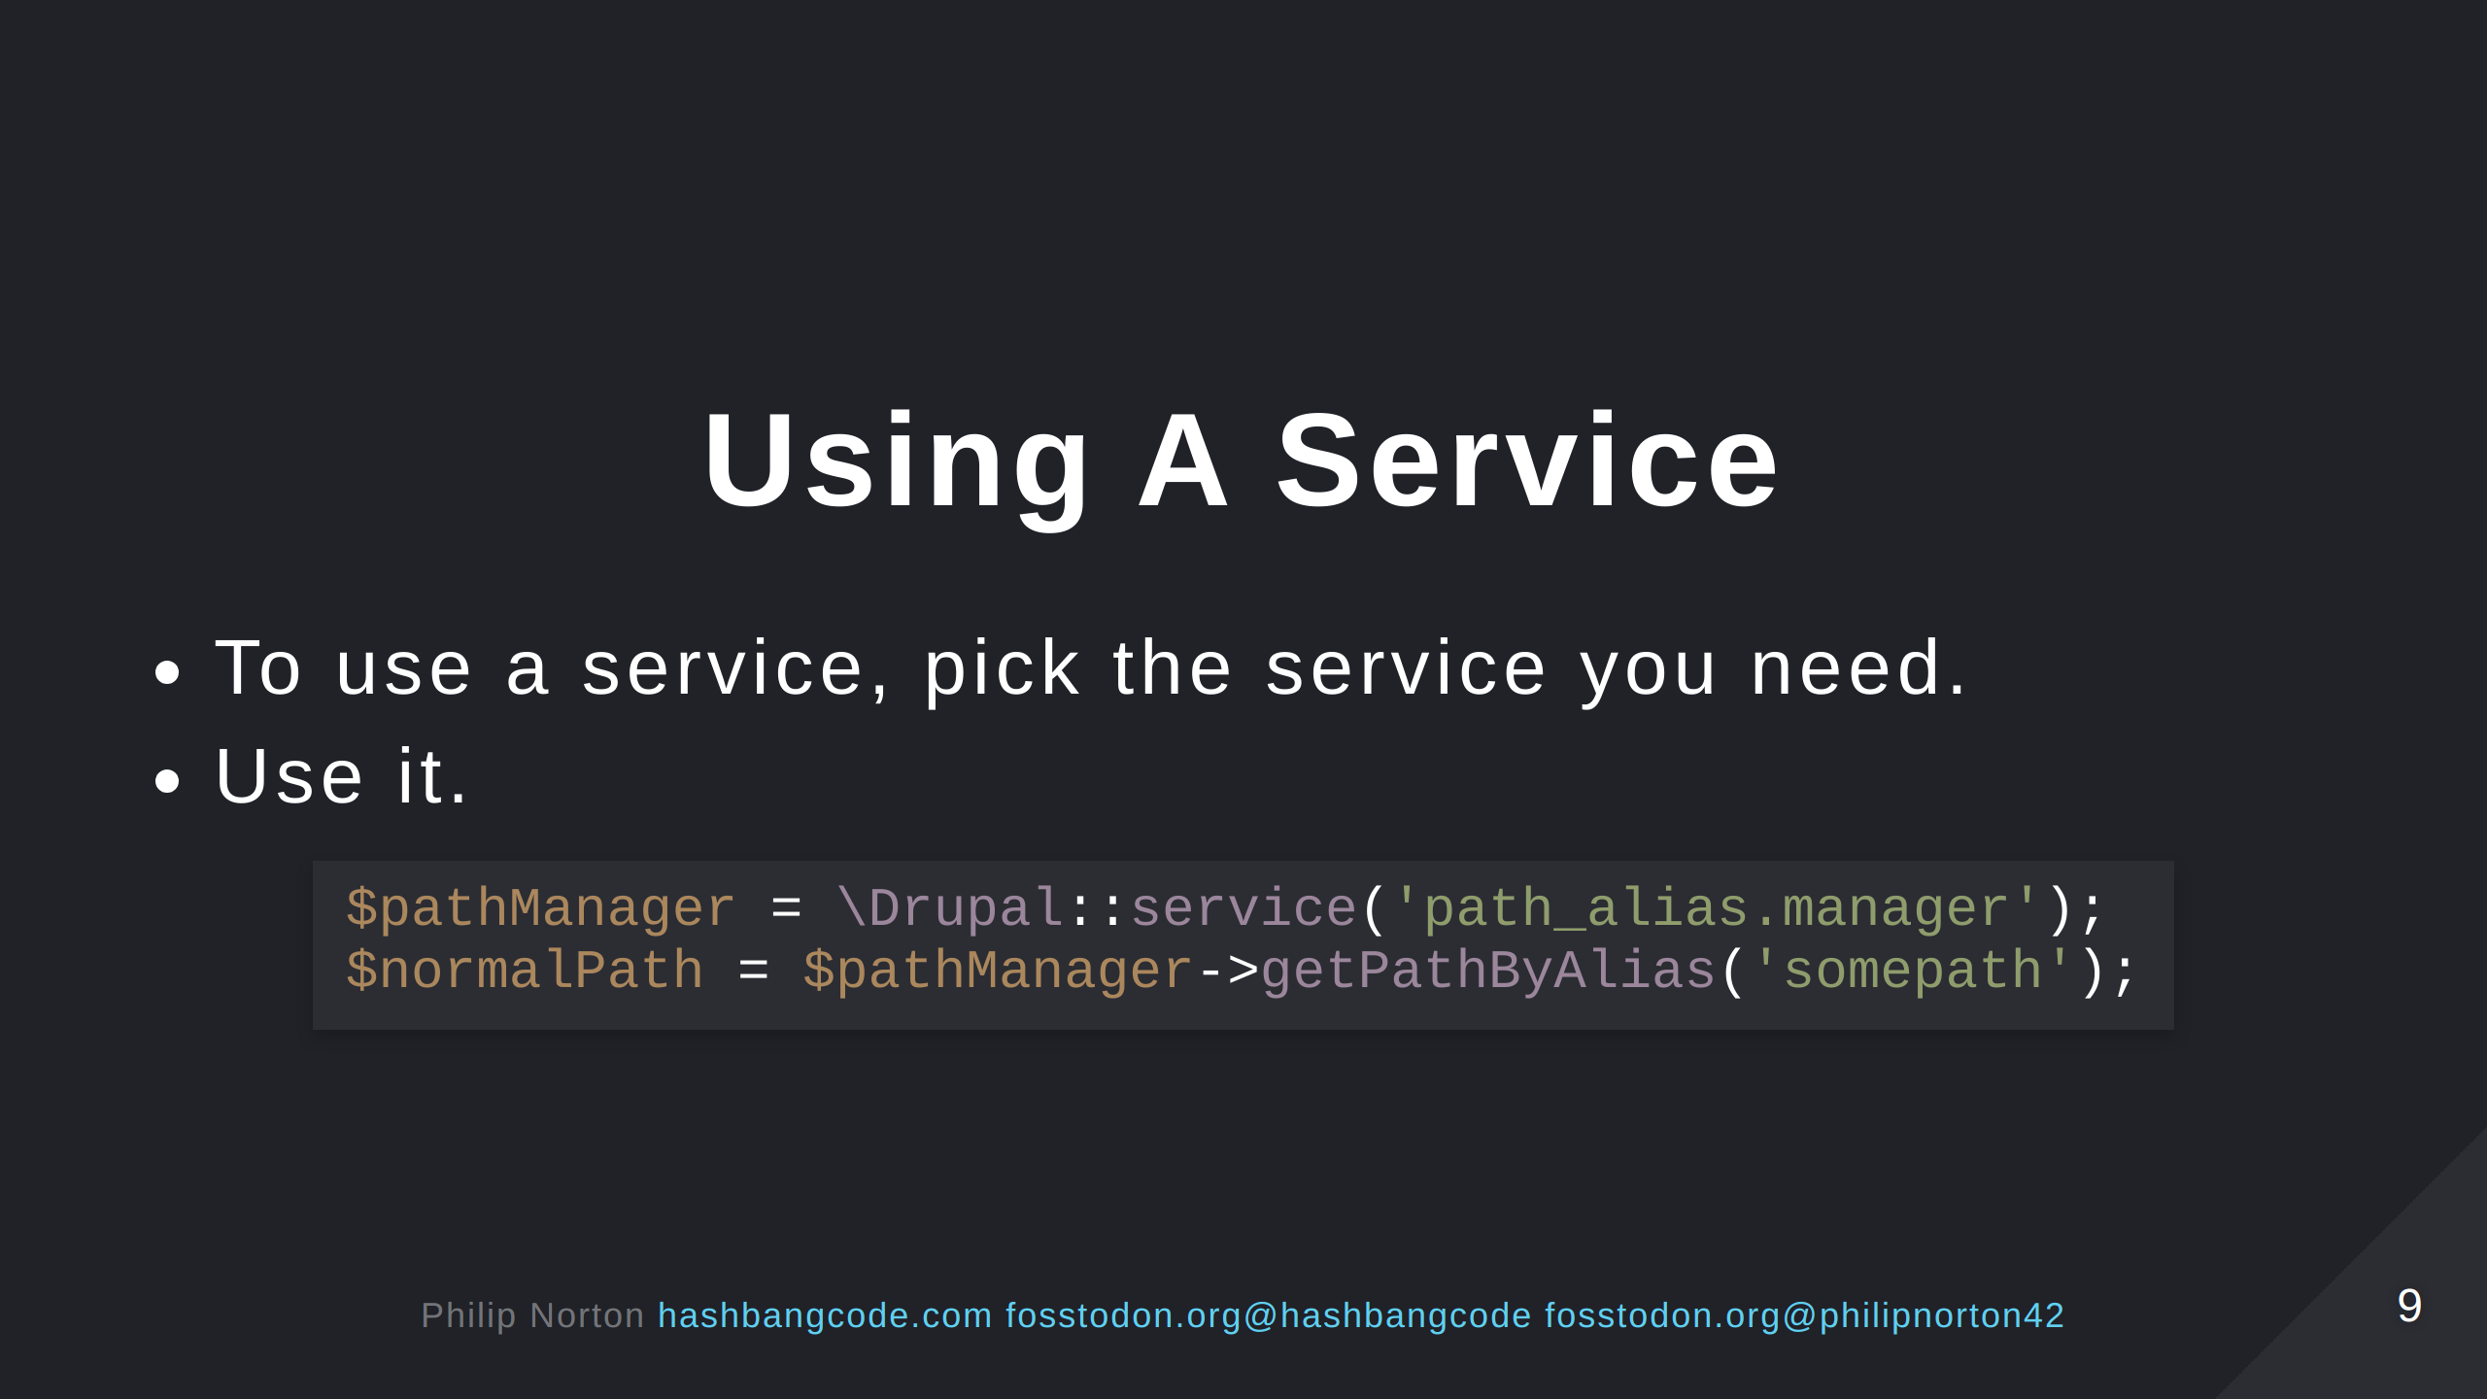
Notes:
This is the path alias manger service. The above code will convert "somepath" into a Drupal path, something like "node/123".

Slide 10
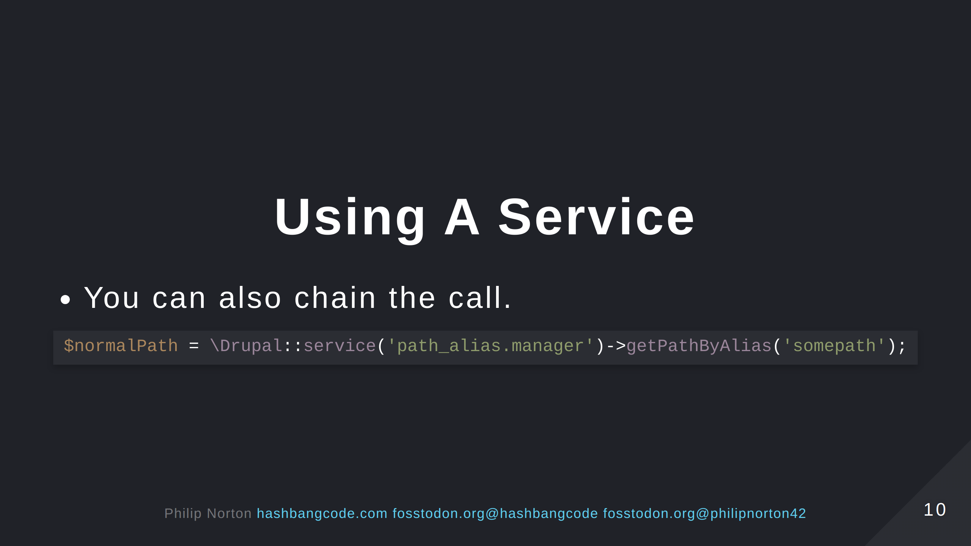

Slide 11
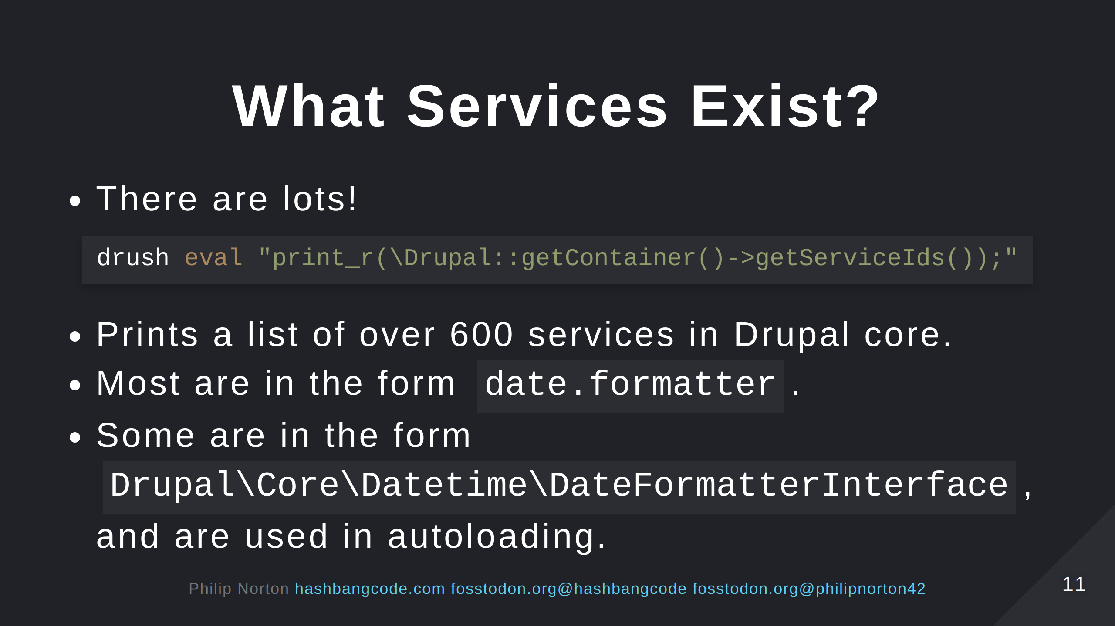

Slide 12
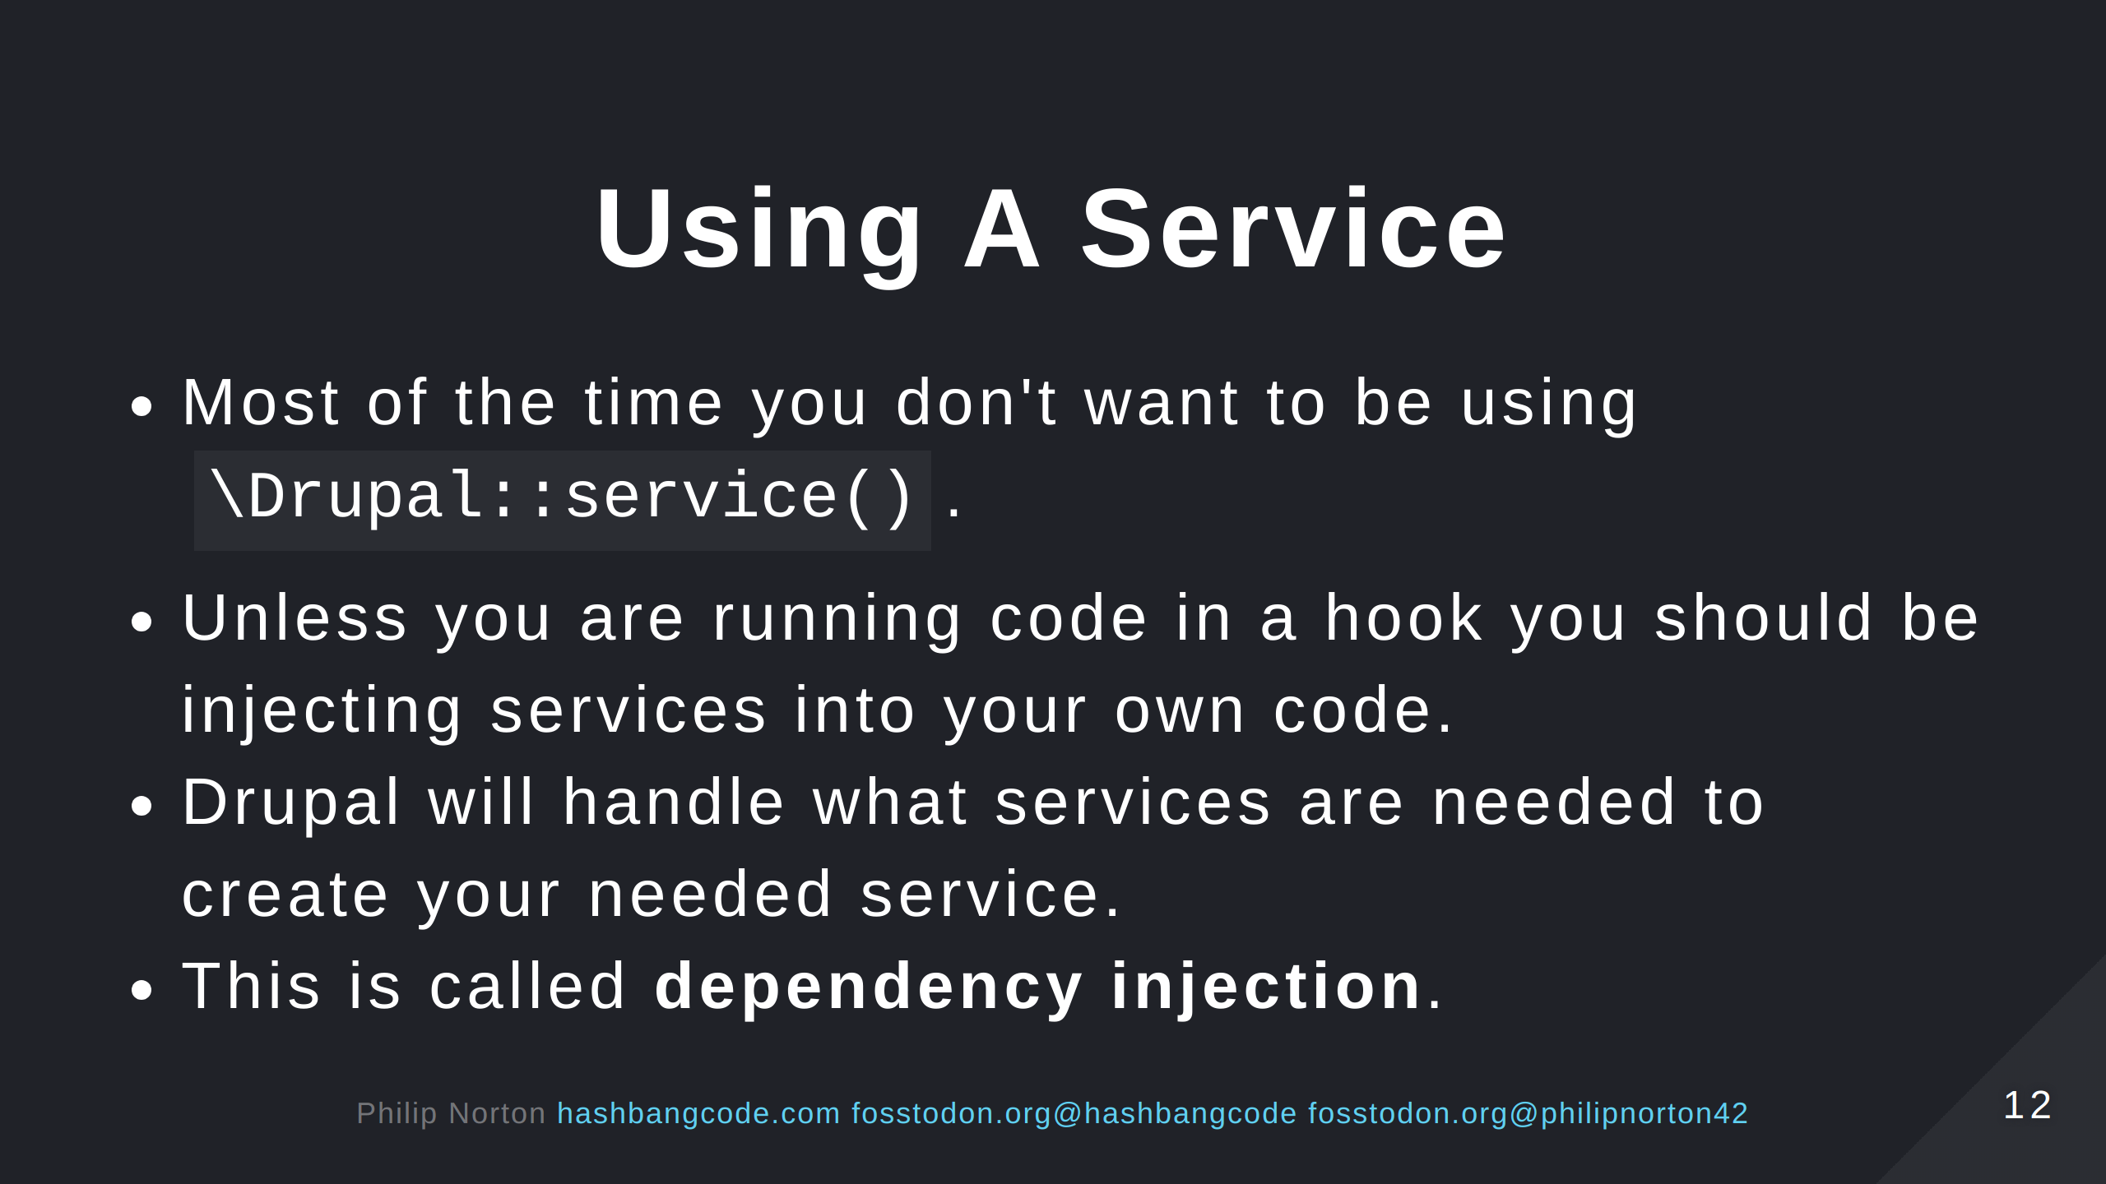

Slide 13
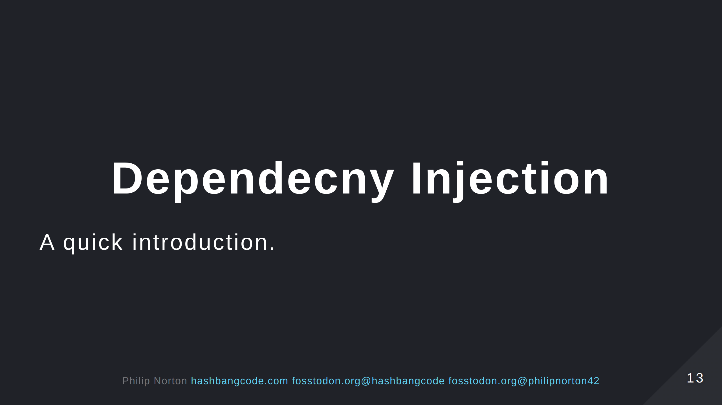

Slide 14
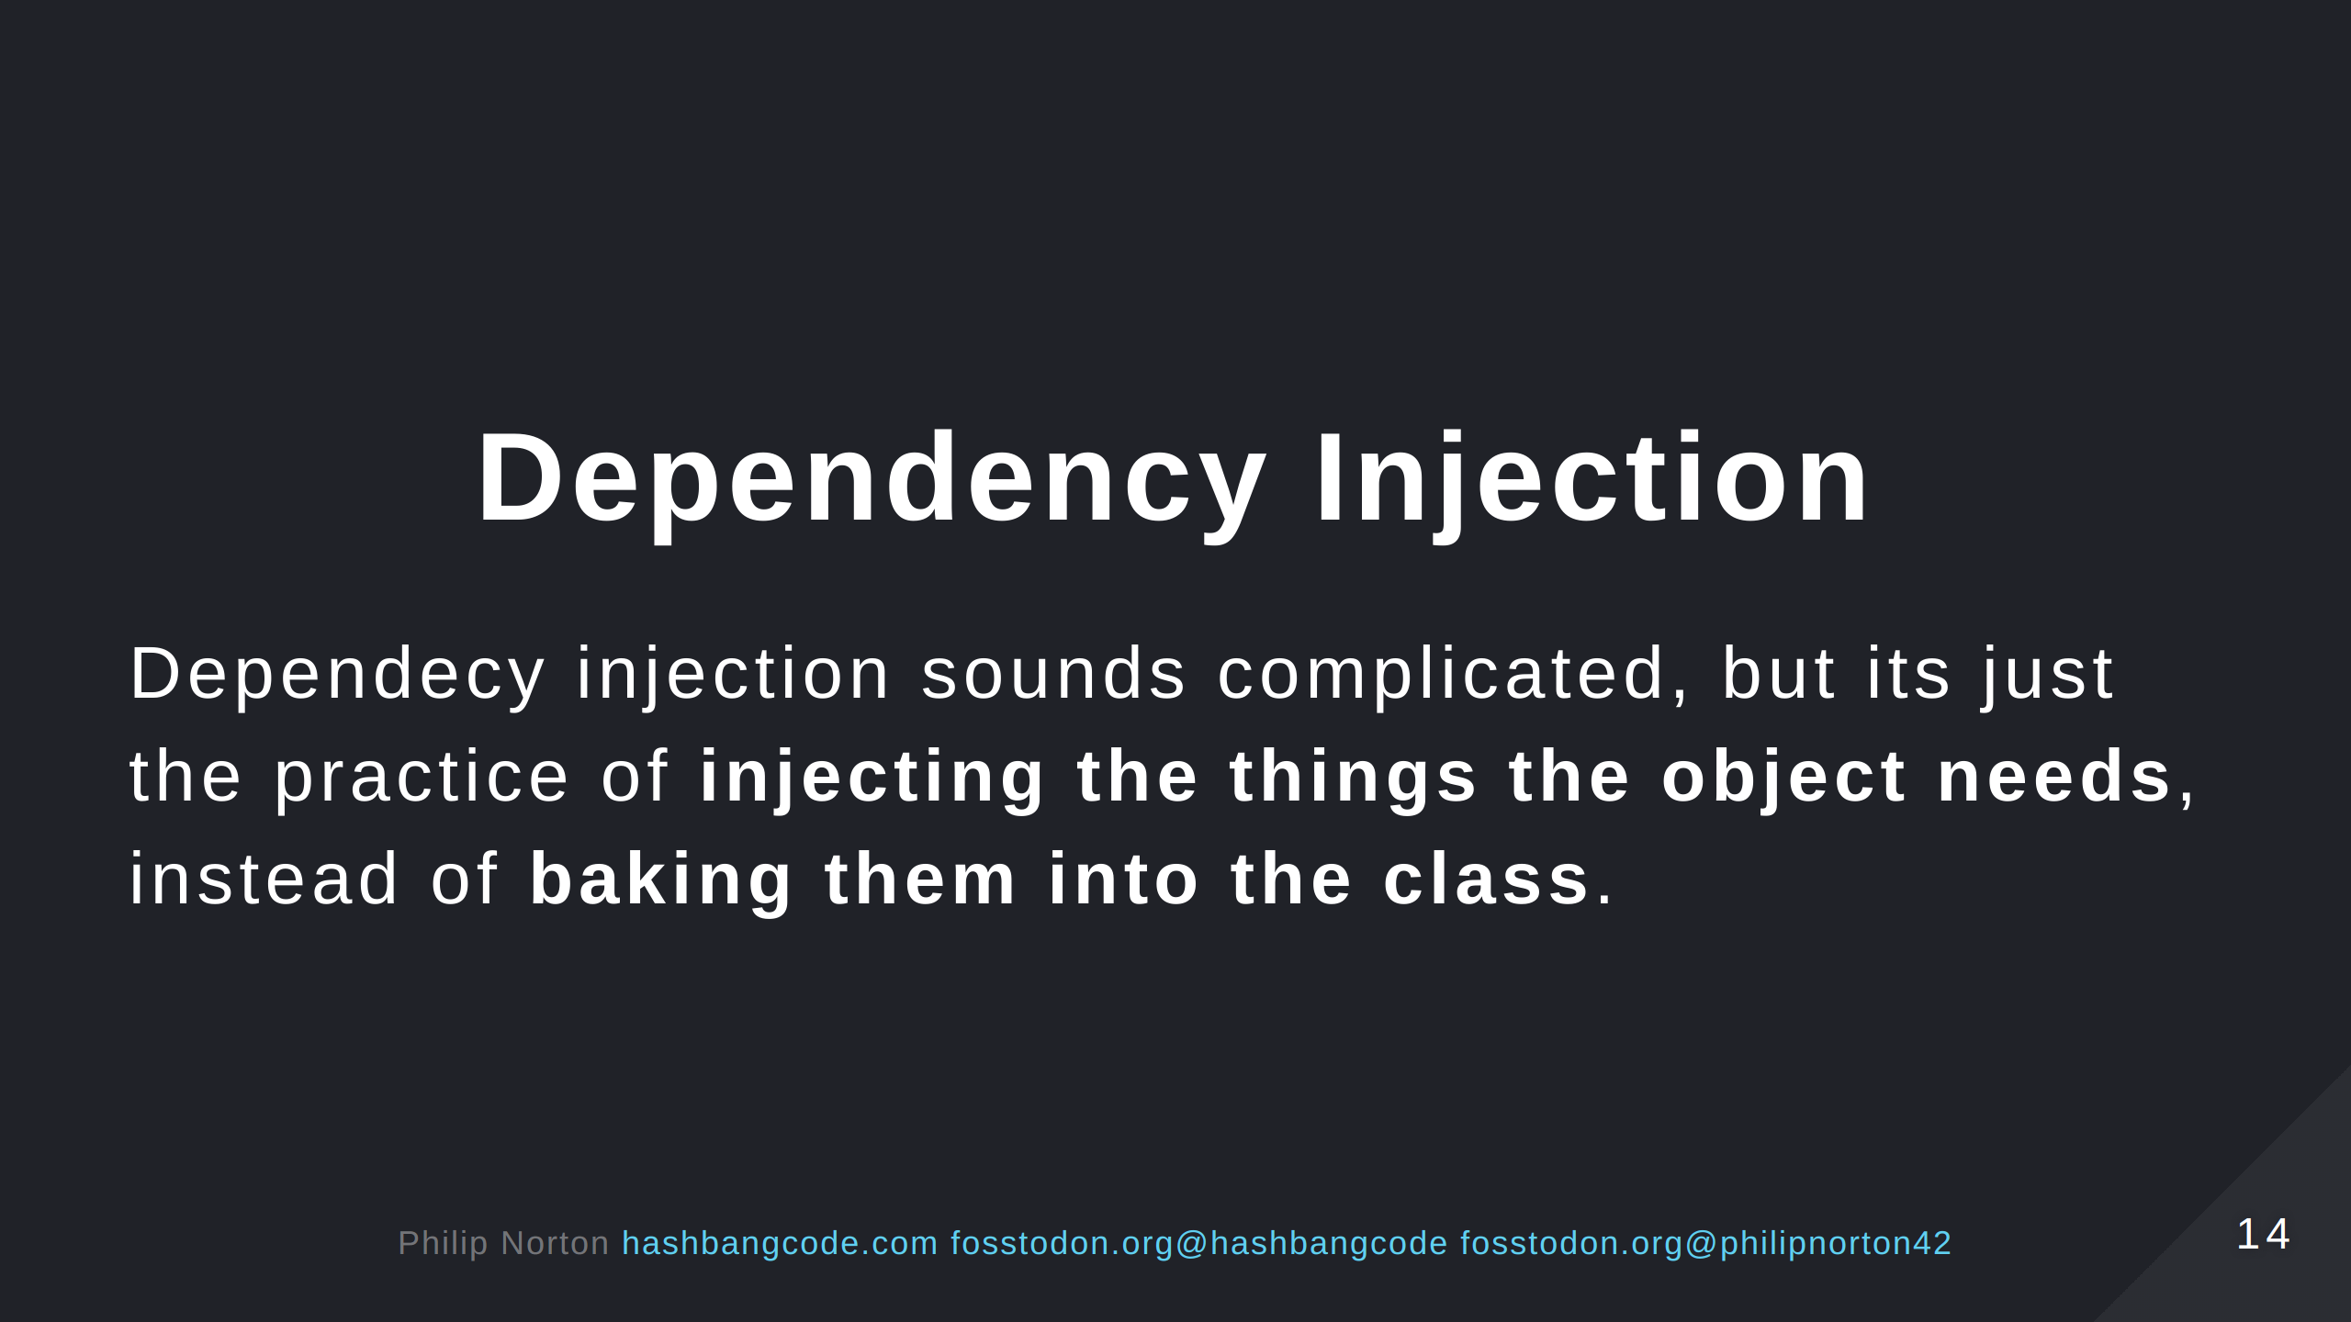

Slide 15
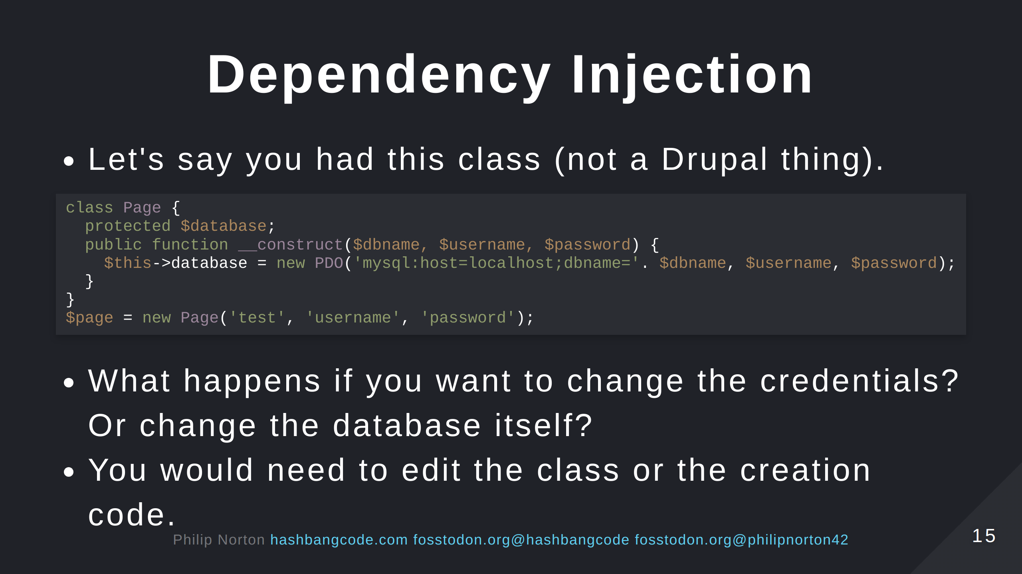
Notes:
Think SOLID principles.

Slide 16
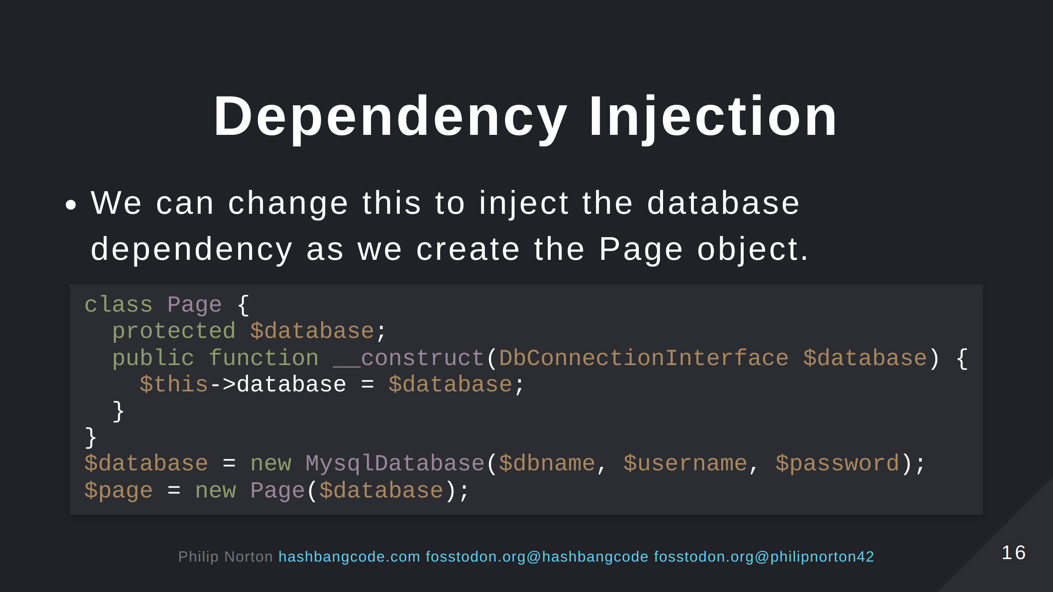
Notes:
Dependency Inversion principle.

Slide 17
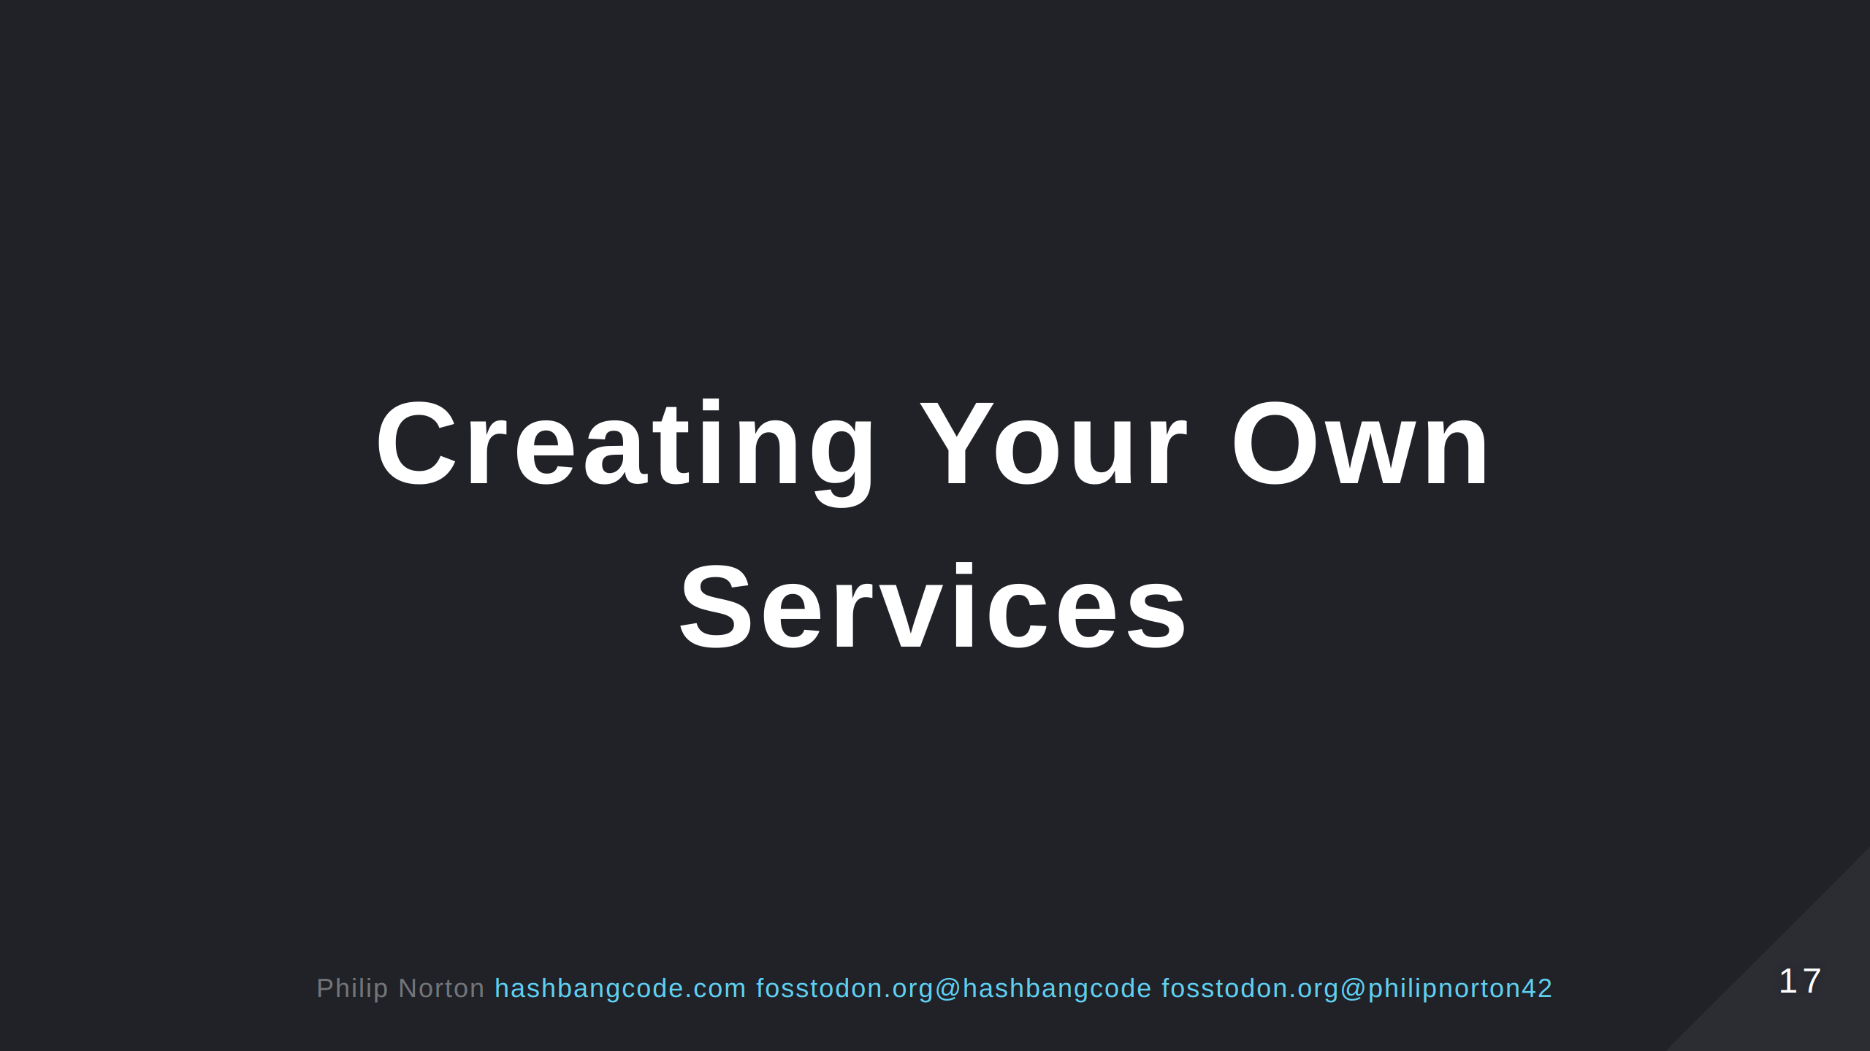

Slide 18
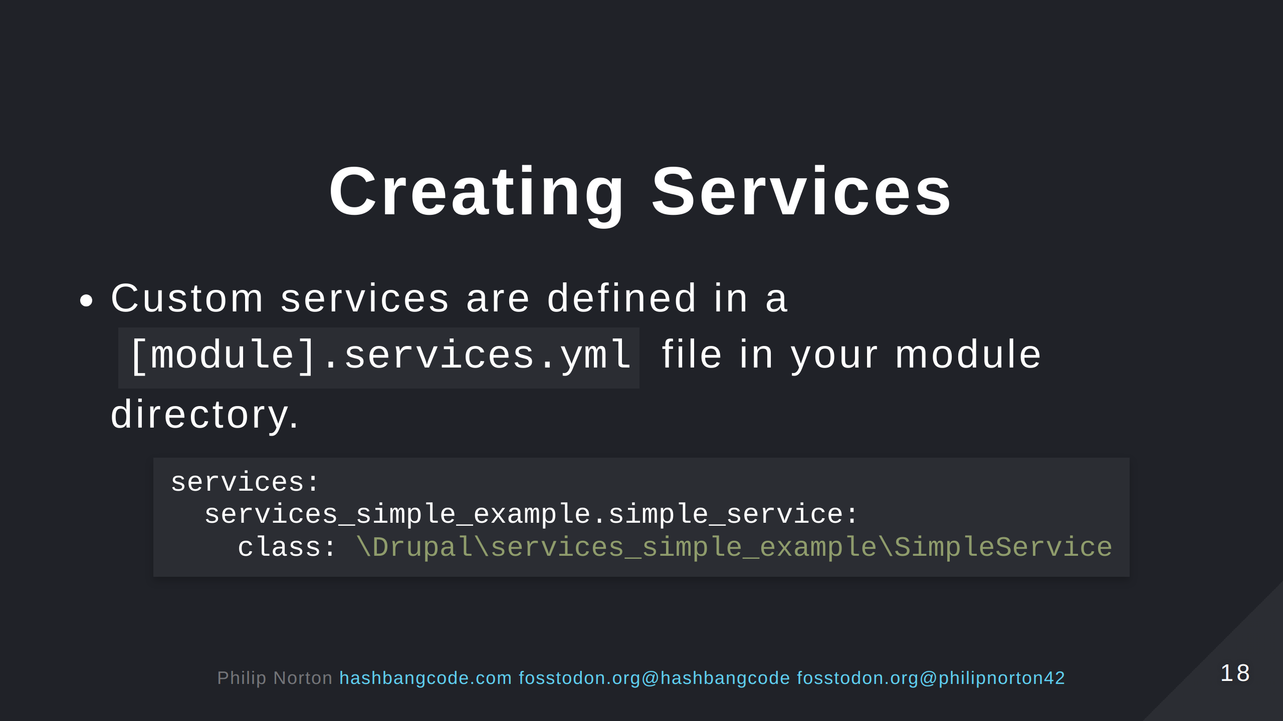

Slide 19
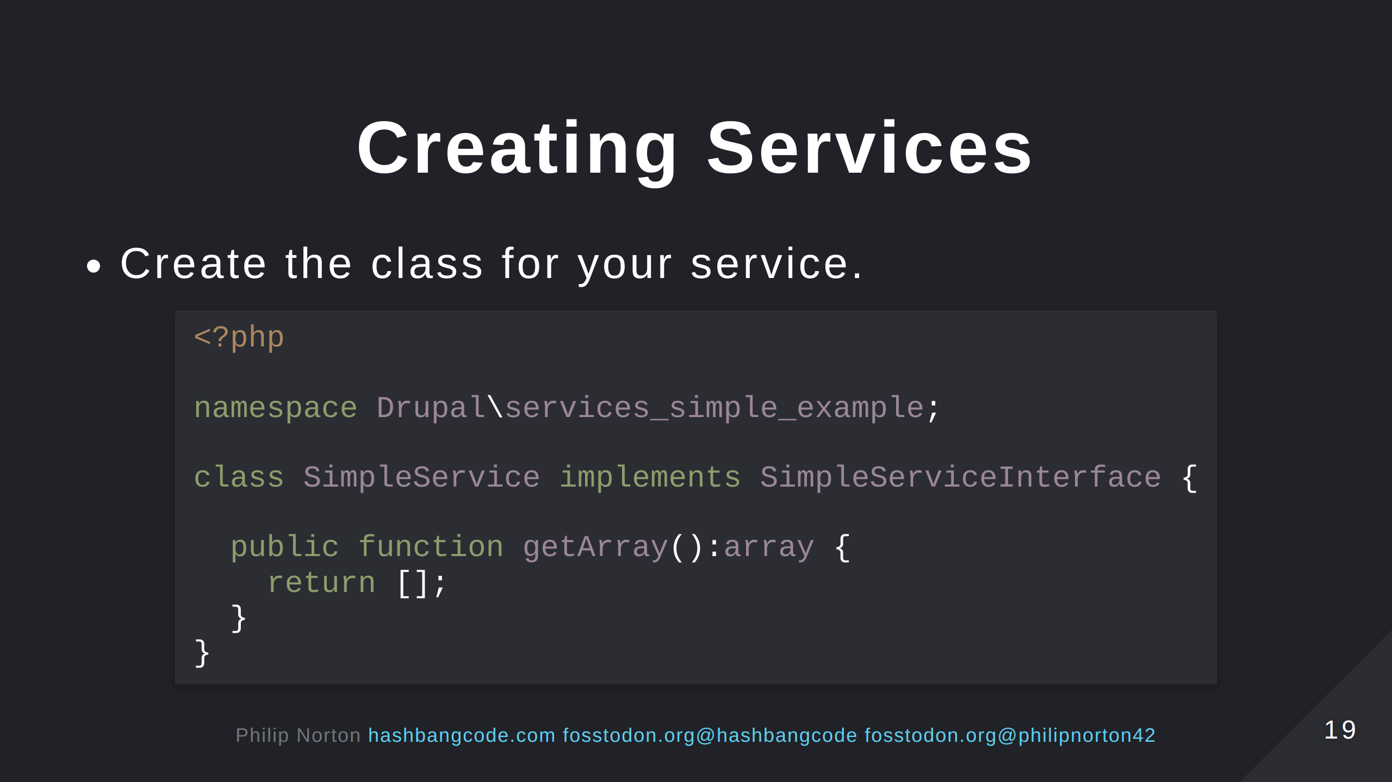

Slide 20
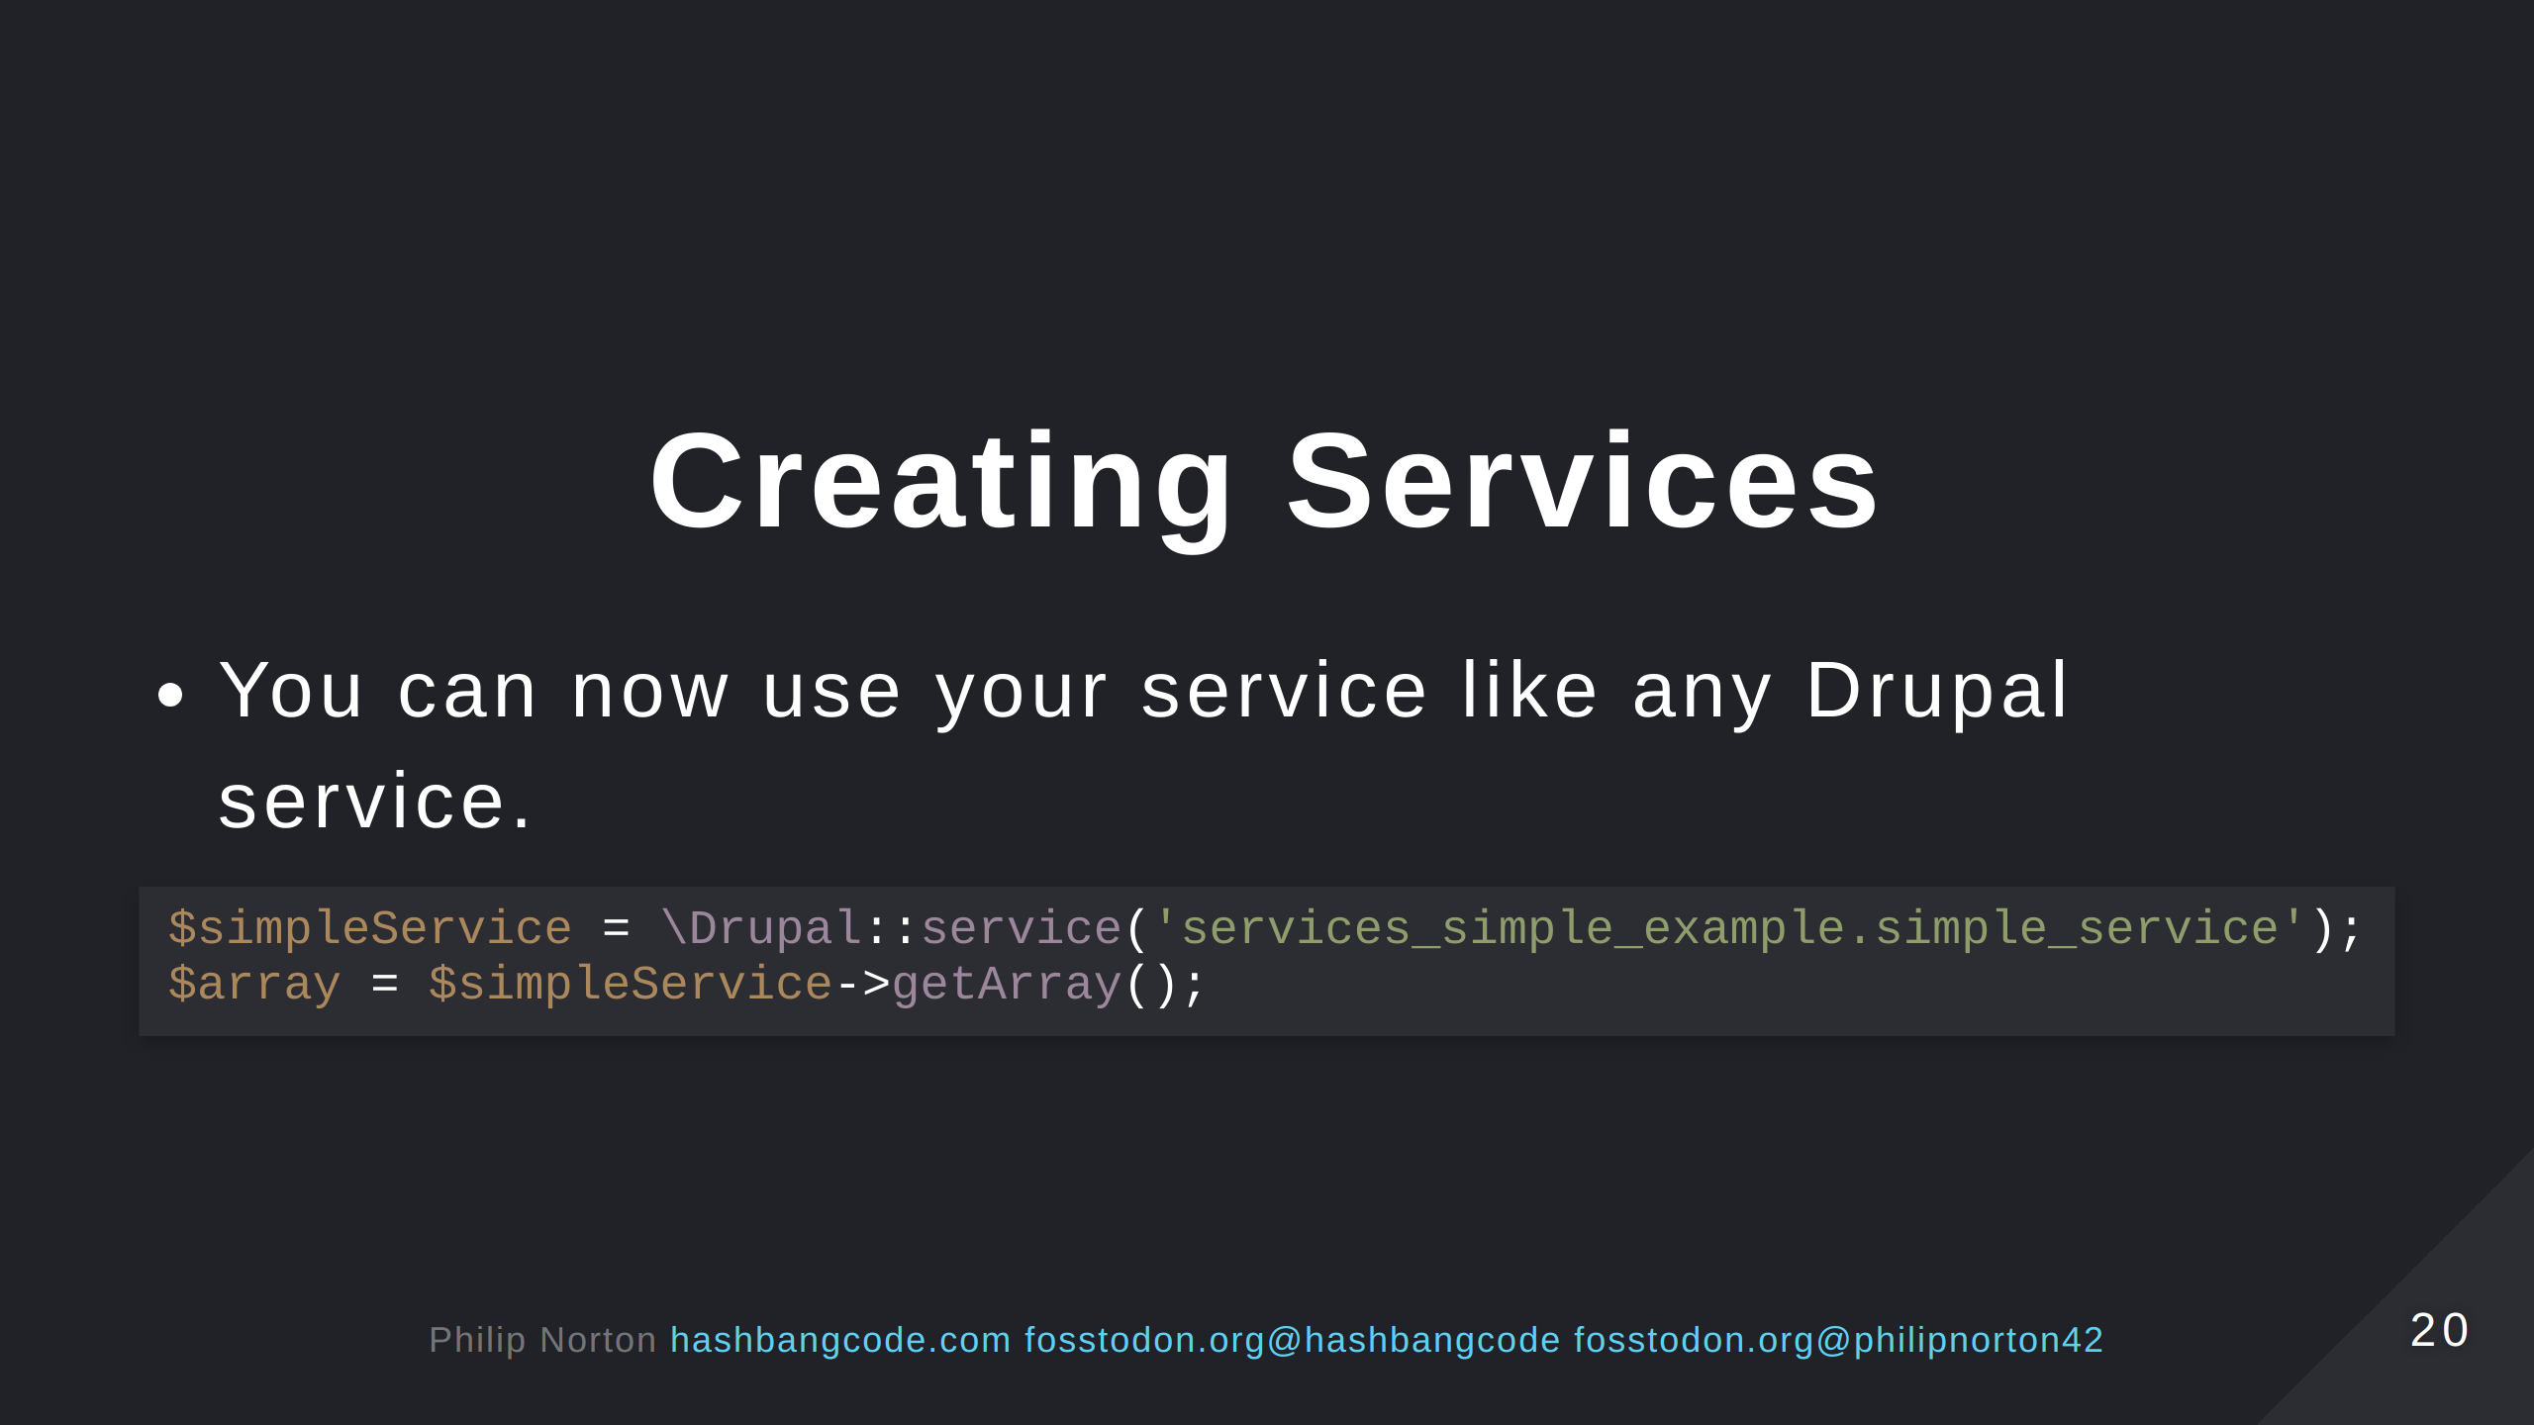

Slide 21
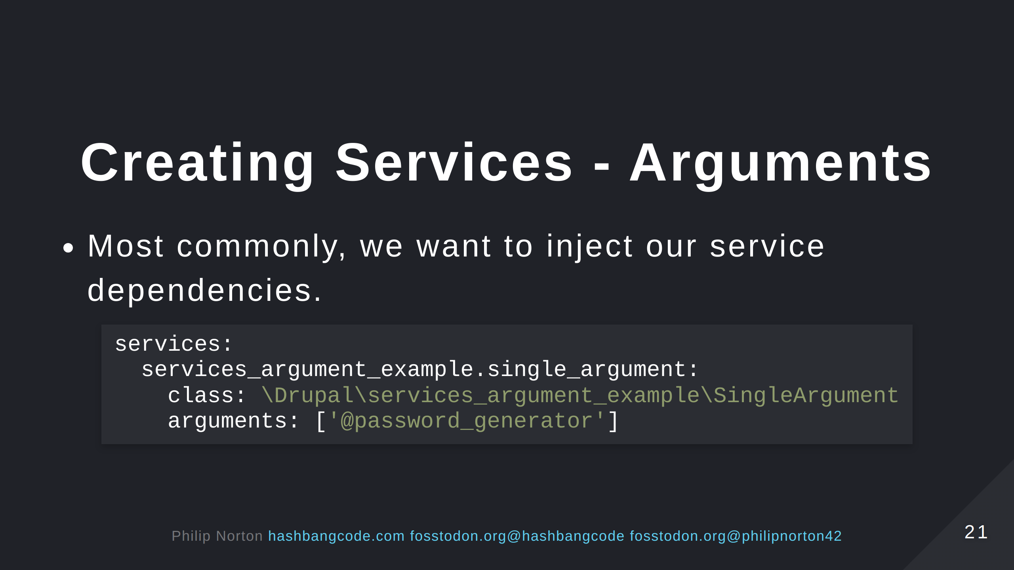
Notes:
We are injecting the service to generate passwords.

Slide 22
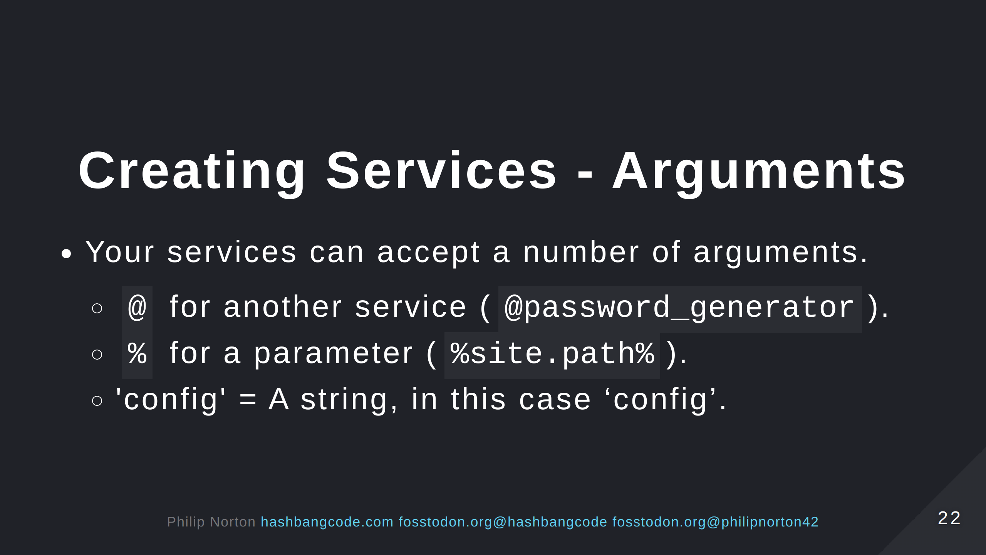
Notes:
Parameters are set in services files, but can be overridden at runtime by Drupal. Strings are used to pass static properties to factories to generate different types of object.

Slide 23
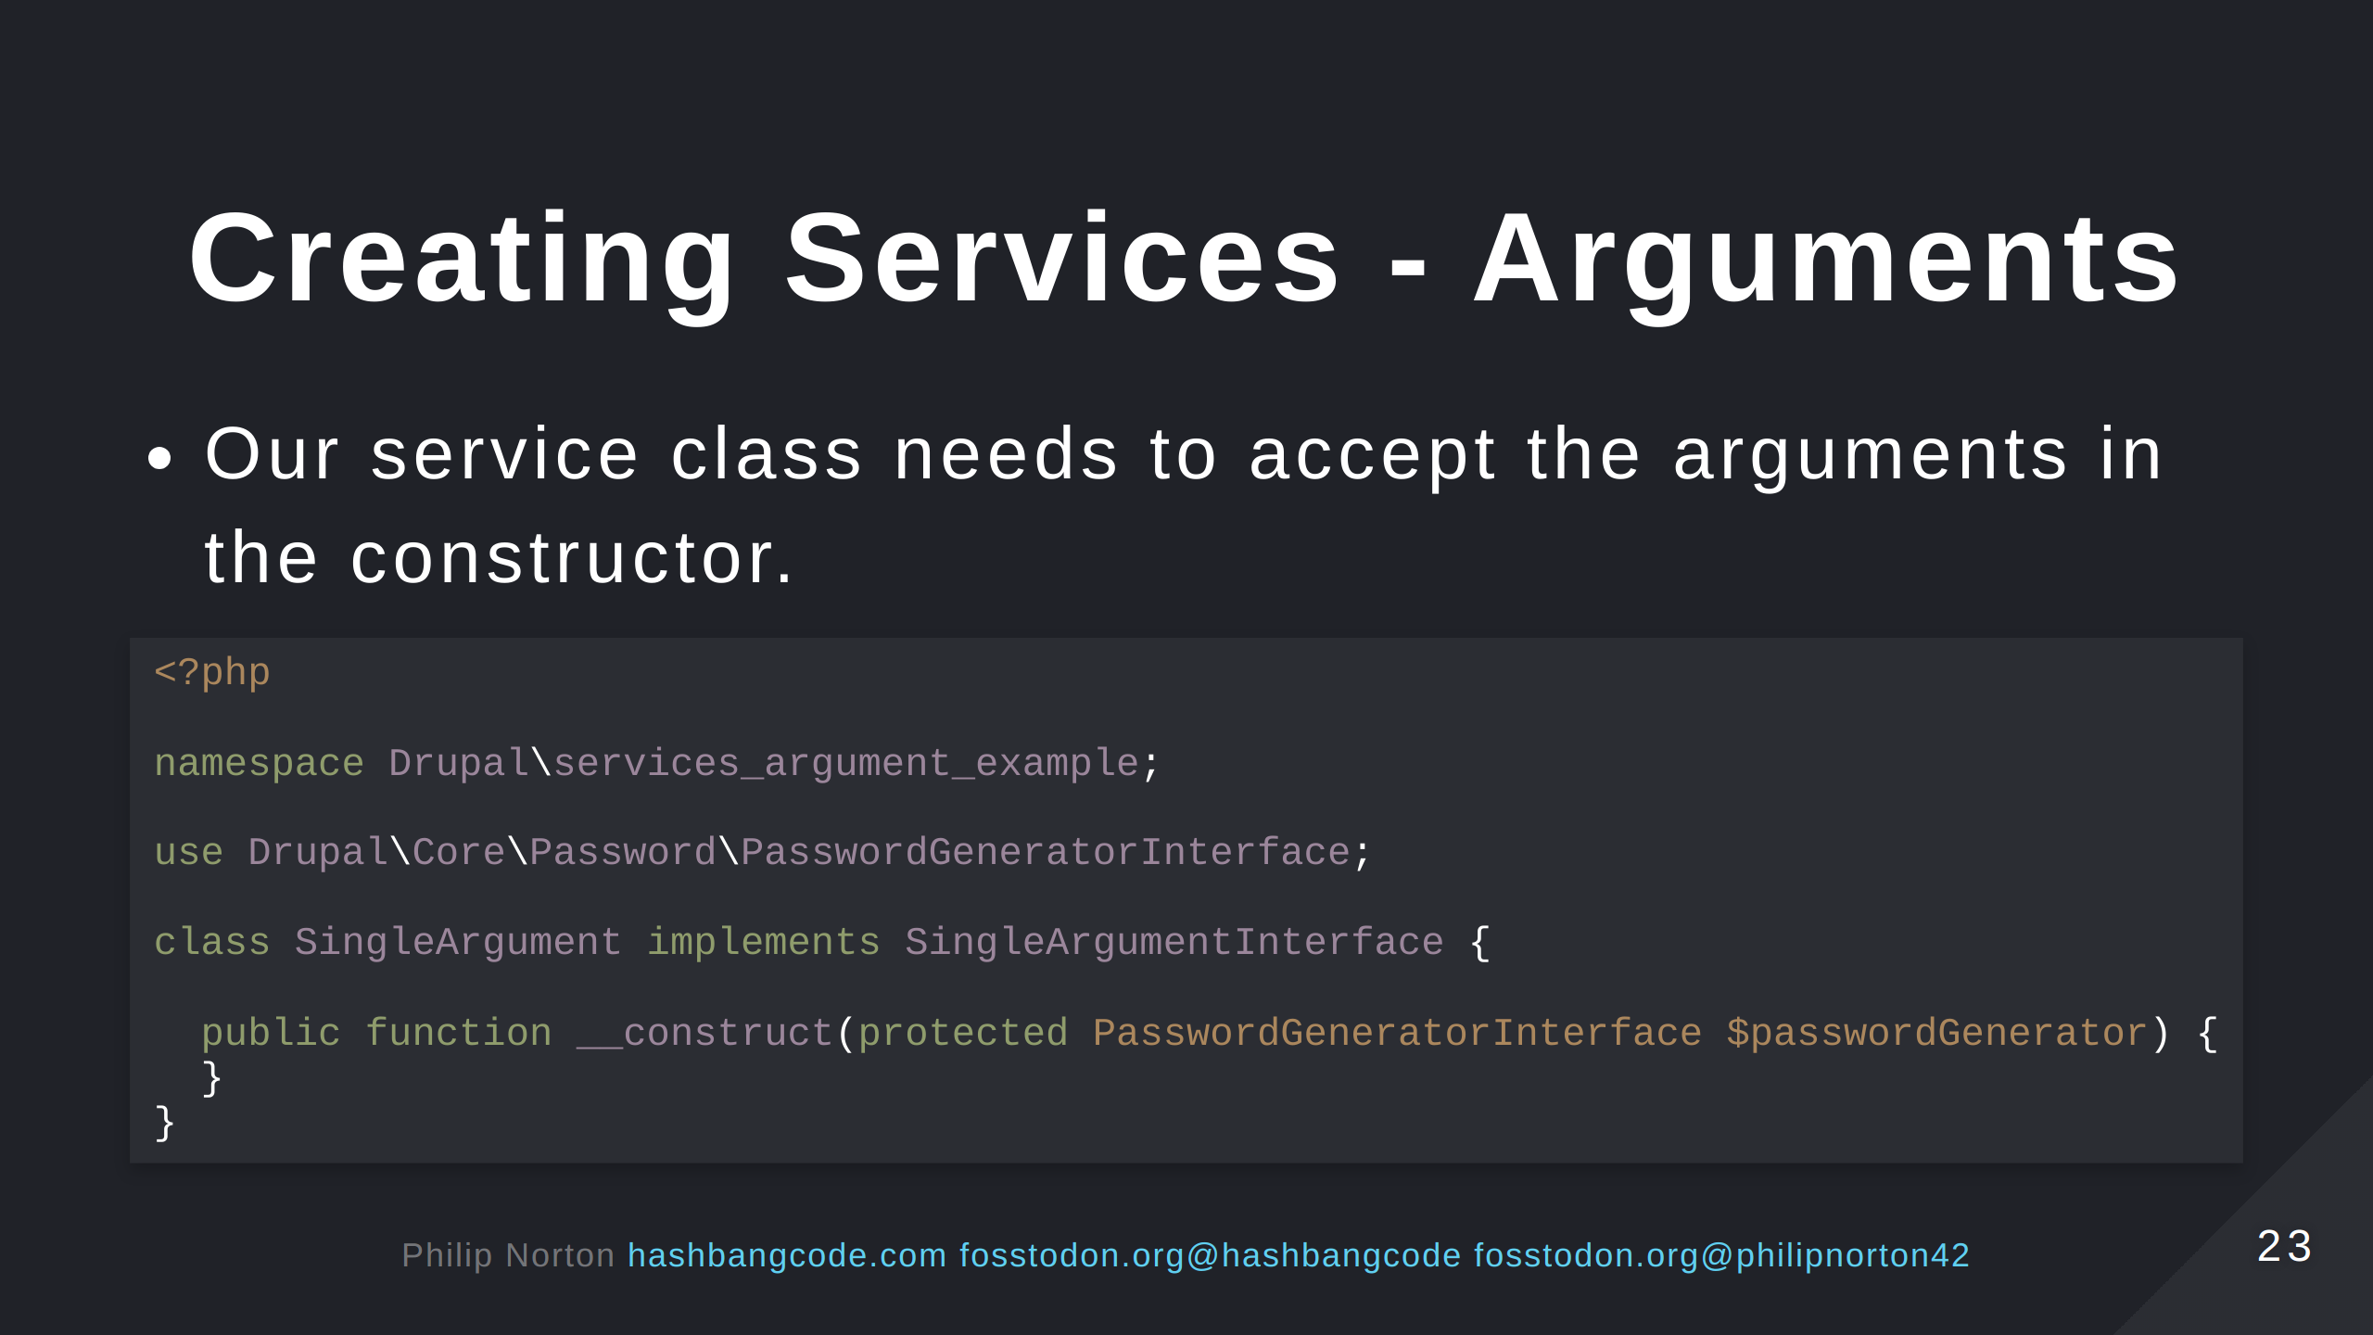
Notes:
This is call constructor property promotion. The $passwordGenerator property is created in our class. Requiring the interface follows SOLID principles, in this case the dependency inversion principle.

Slide 24
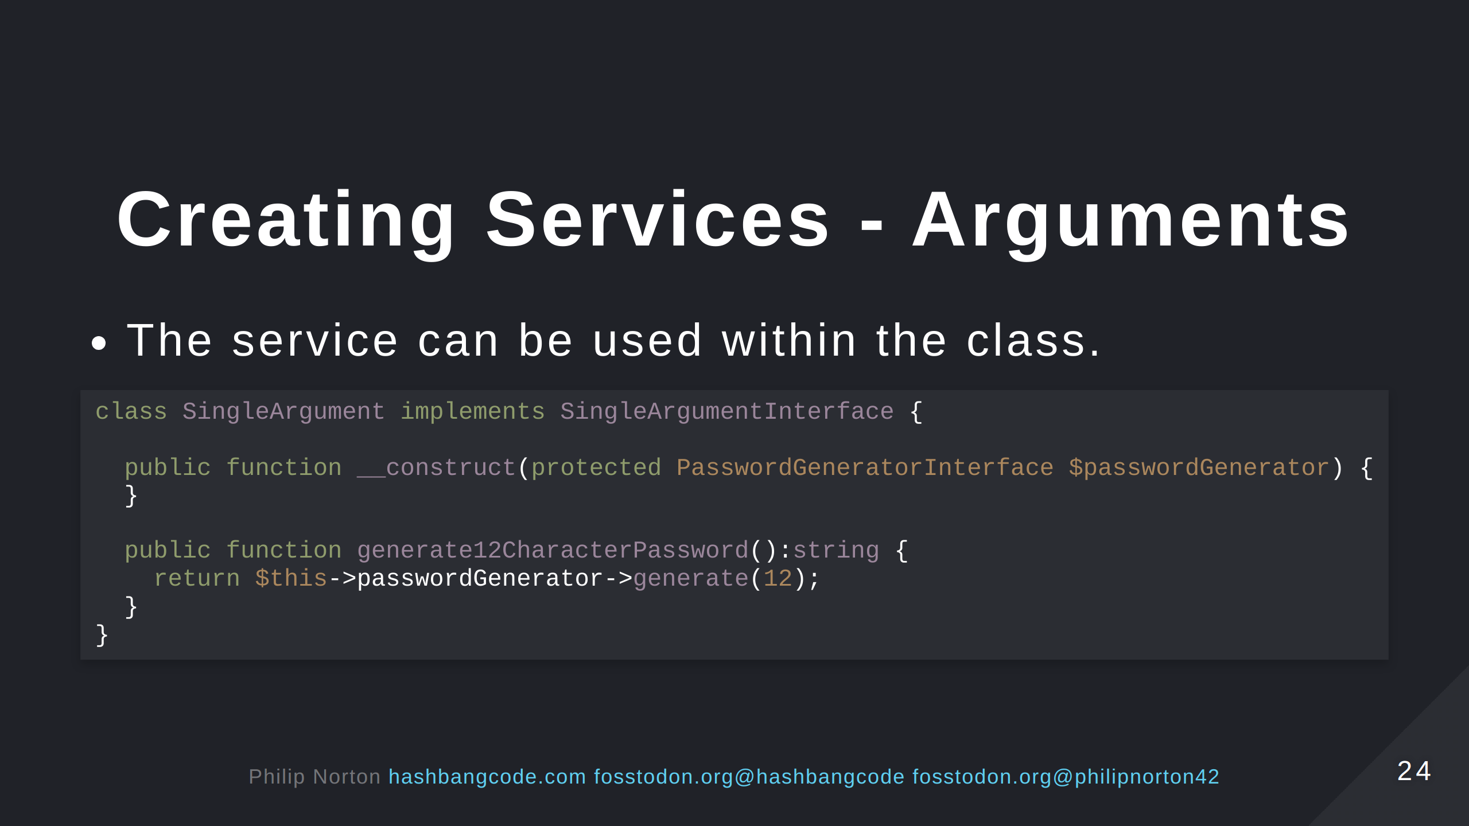

Slide 25
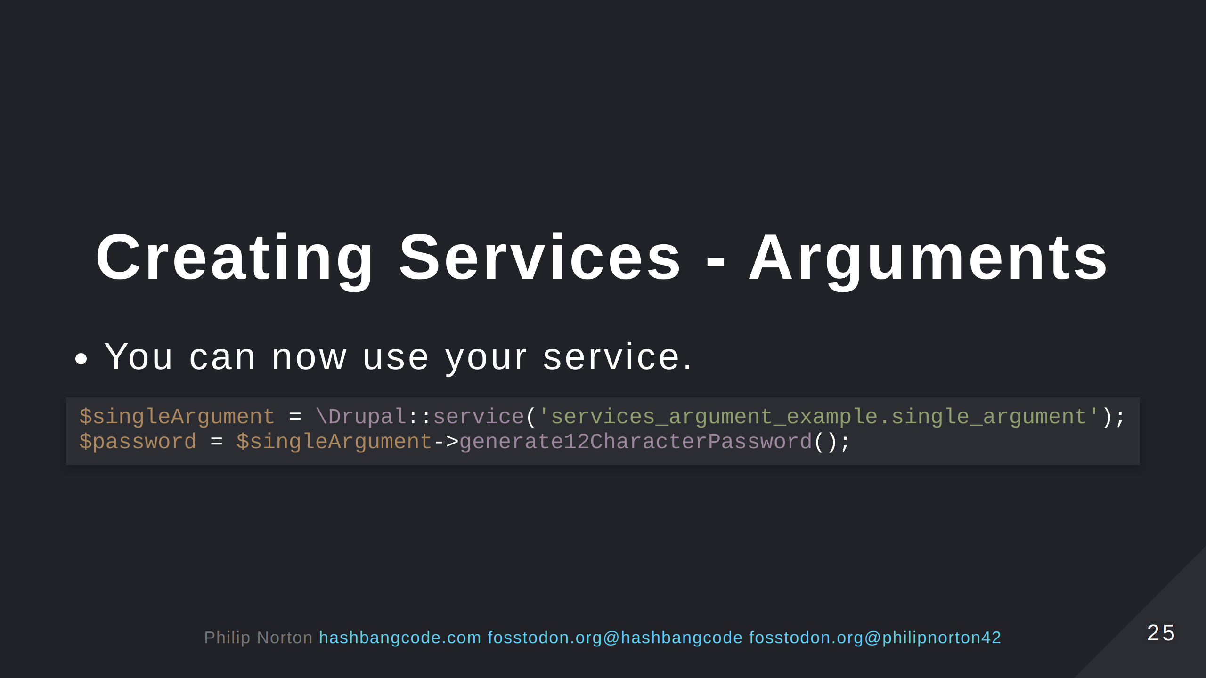

Slide 26
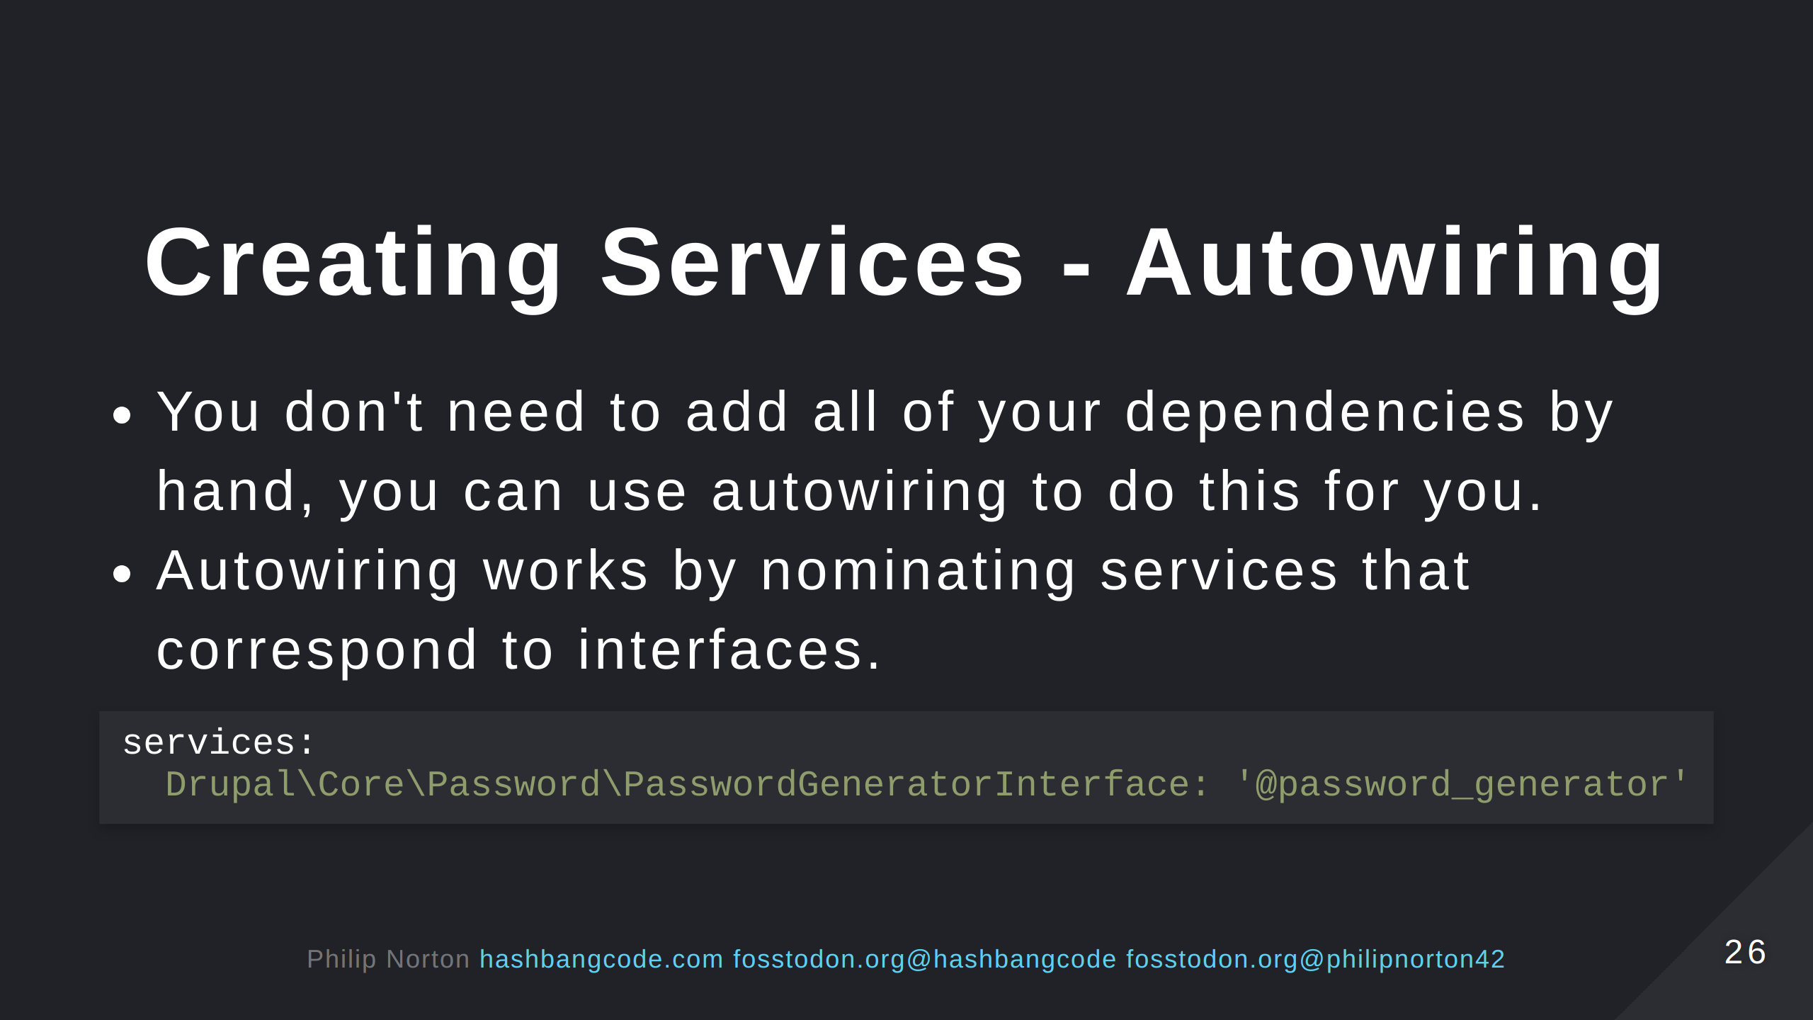
Notes:
This is from the Drupal core.services.yml file, where a lot of services are defined.

Slide 27
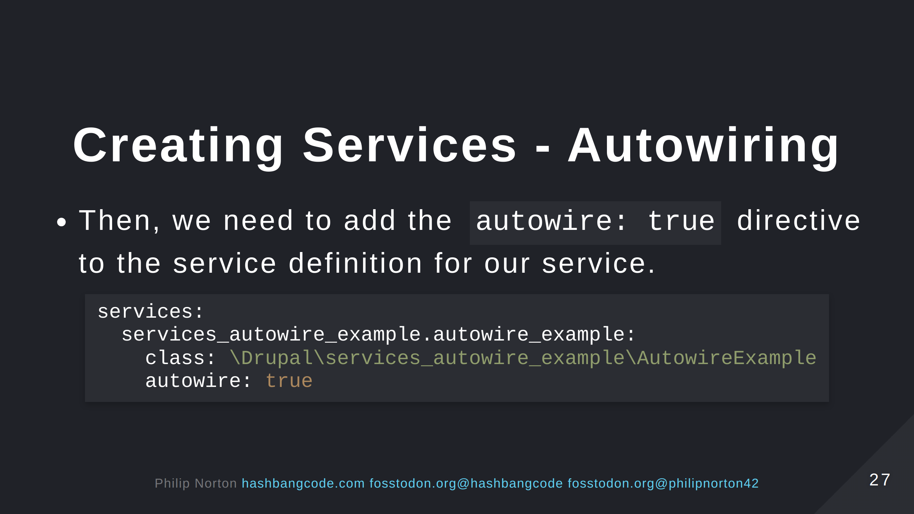

Slide 28
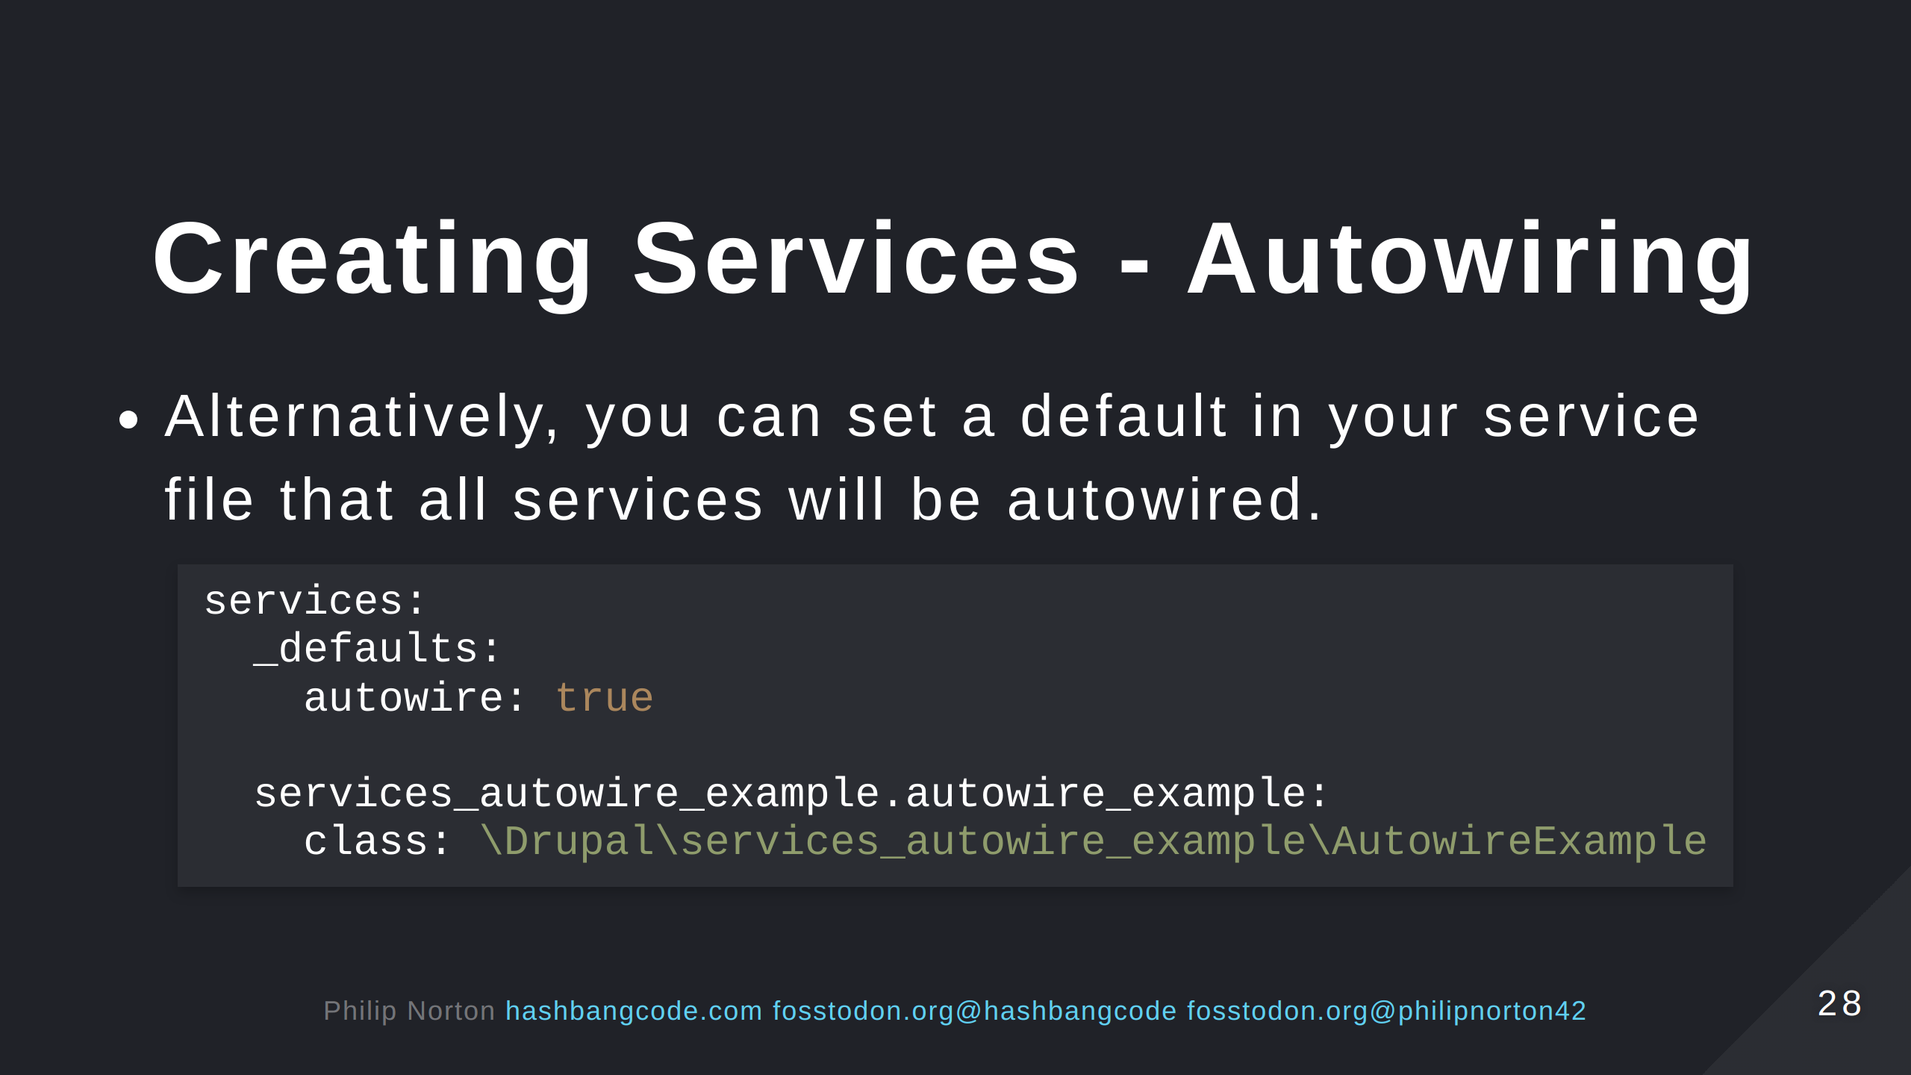

Slide 29
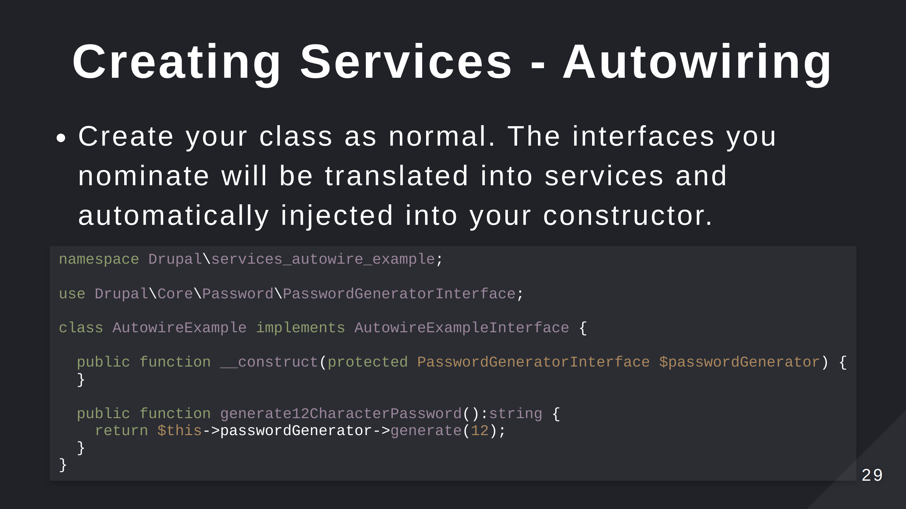

Slide 30


Slide 31
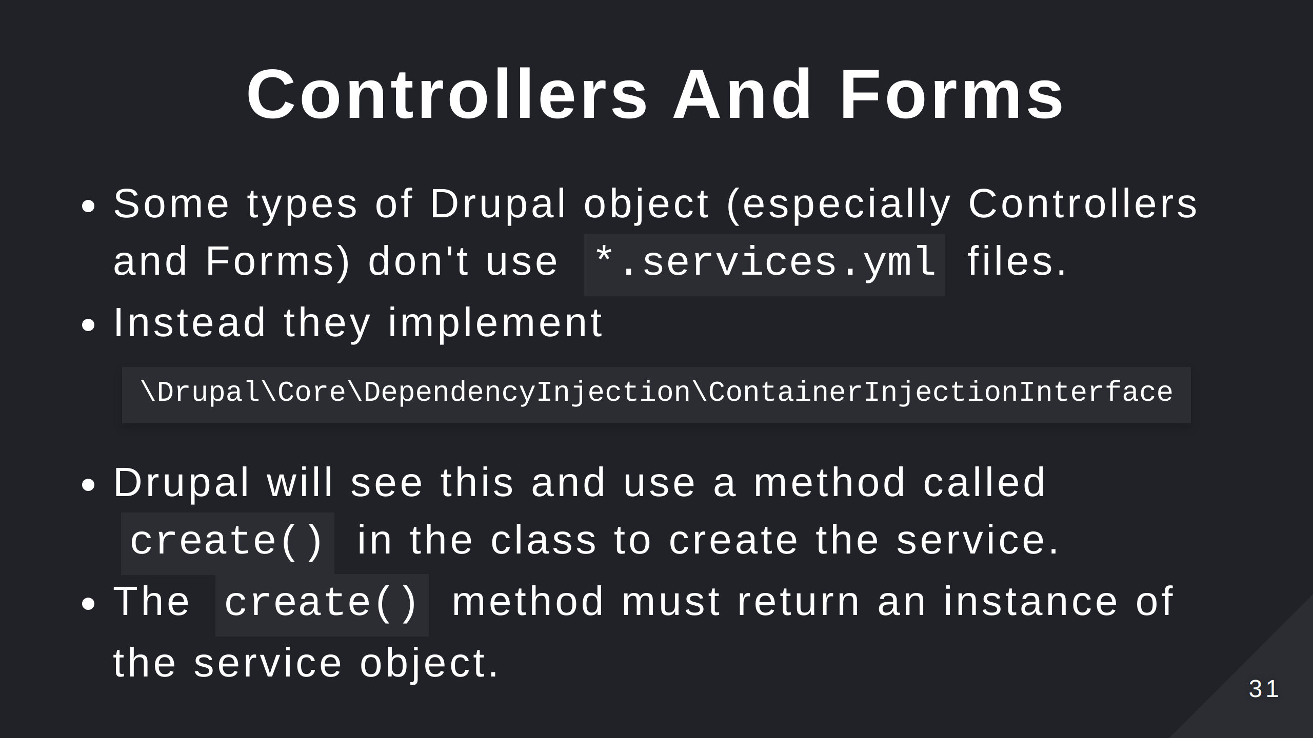

Slide 32
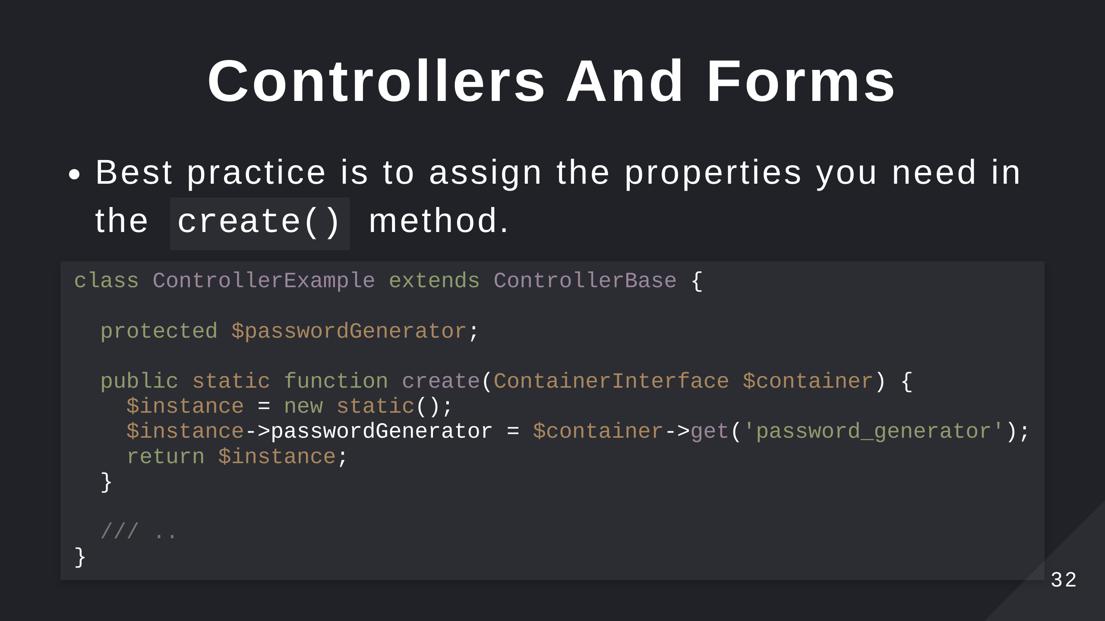
Notes:
The static() here is a reference to the current class. This calls the constructor but you probably don't need to define the controller.

Slide 33
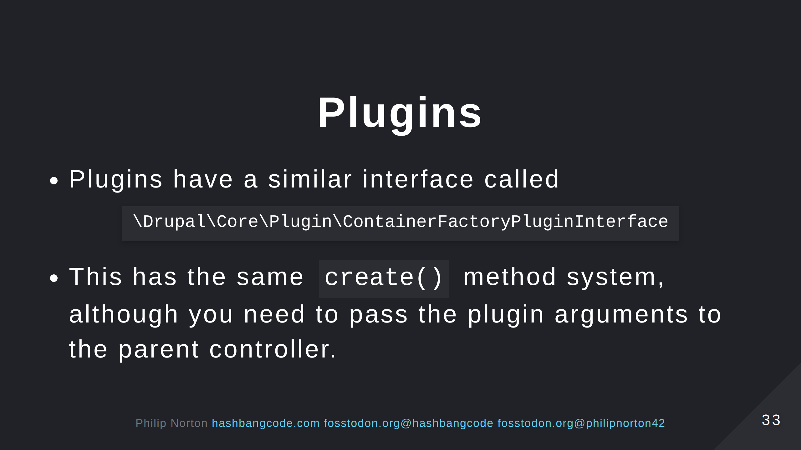
Notes:
Plugins work in the same way, but plugins will have additional arguments that need to be passed upstream.

Slide 34
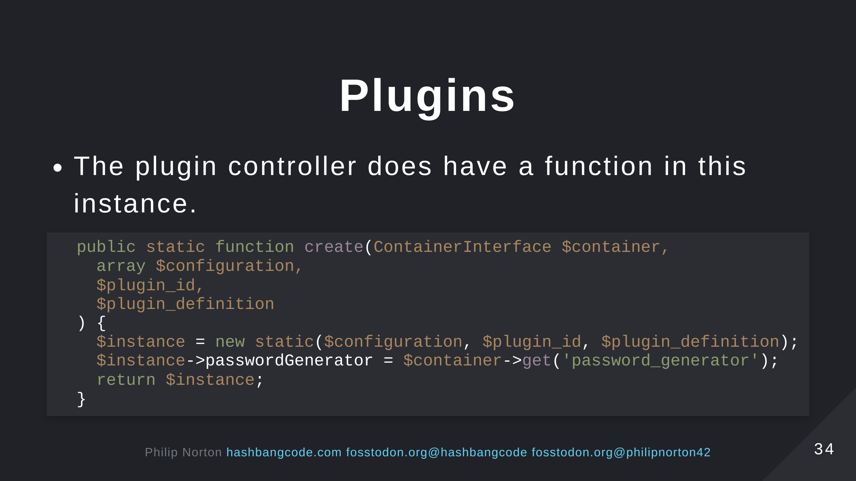
Notes:
This technique comes in useful when making blocks, creating views plugsin, migration plugins and so on.

Slide 35


Slide 36
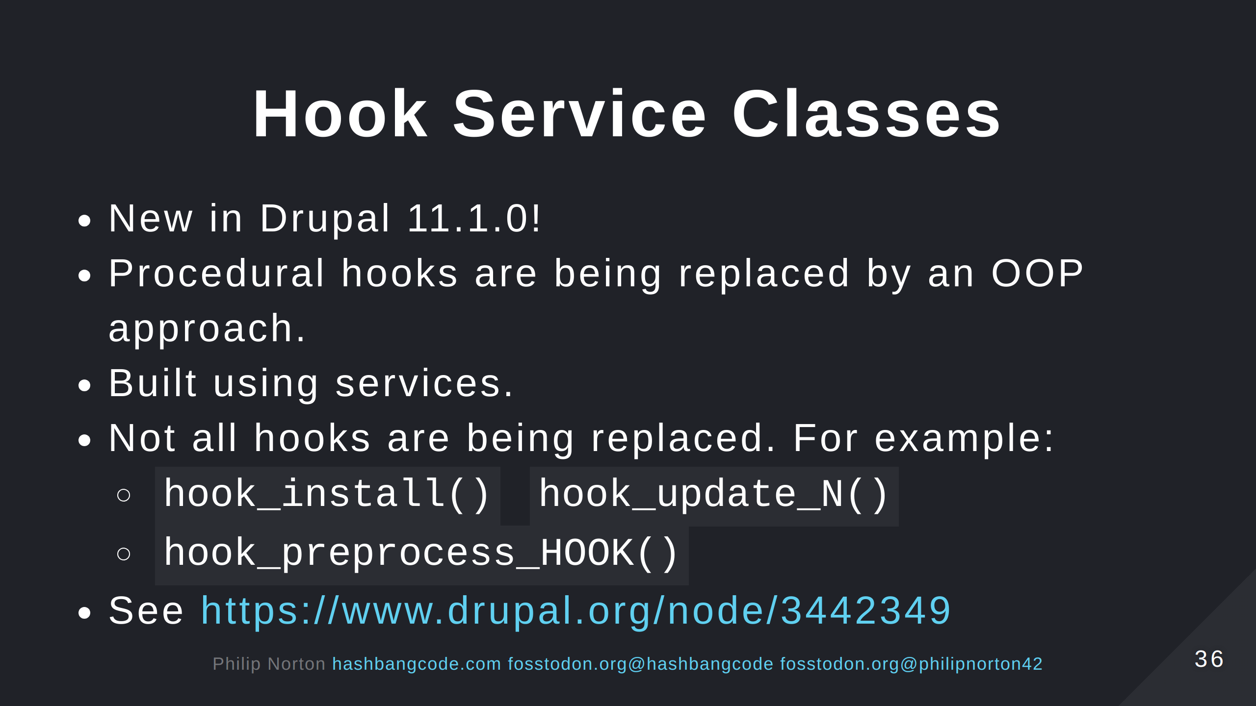
Notes:
This isn't a rug pull. All your normal hooks will work for the time being (we'll come onto that).

Slide 37
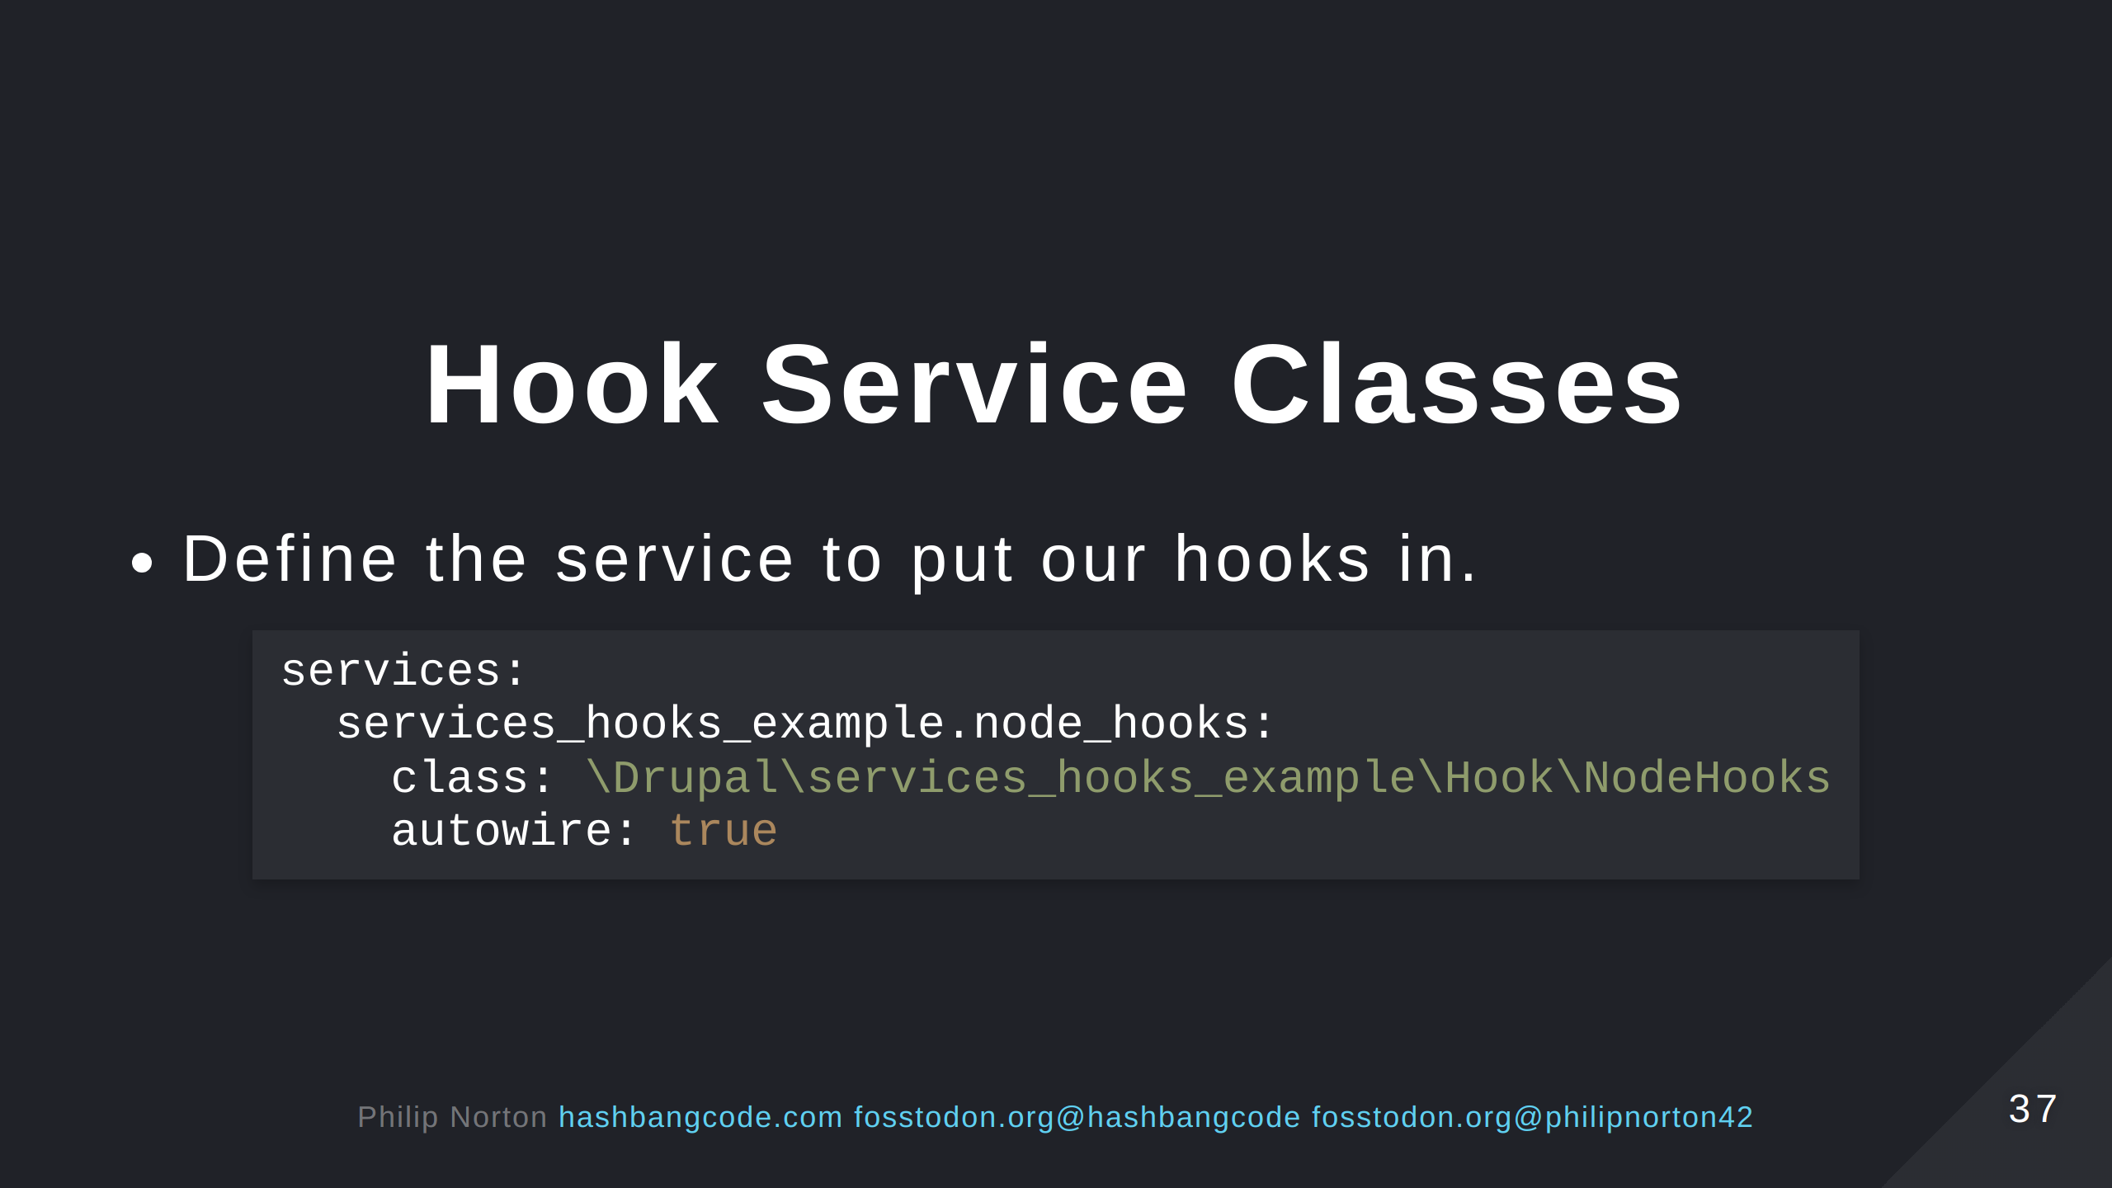

Slide 38
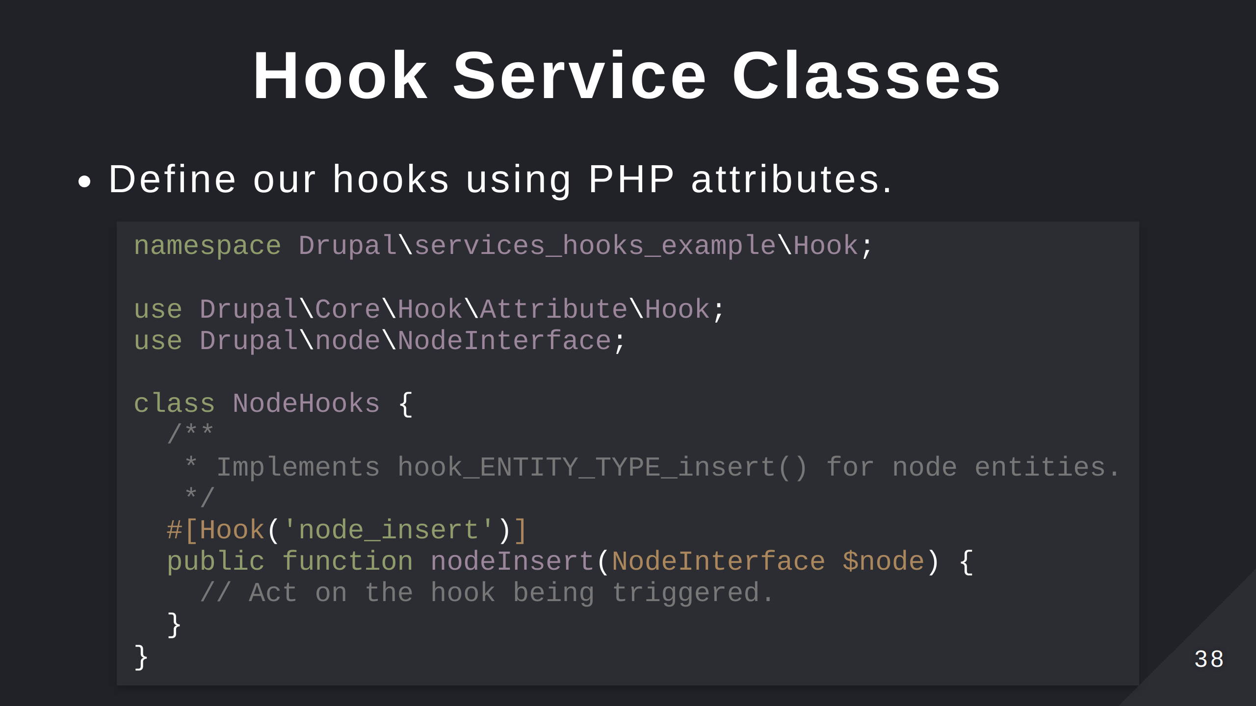

Slide 39
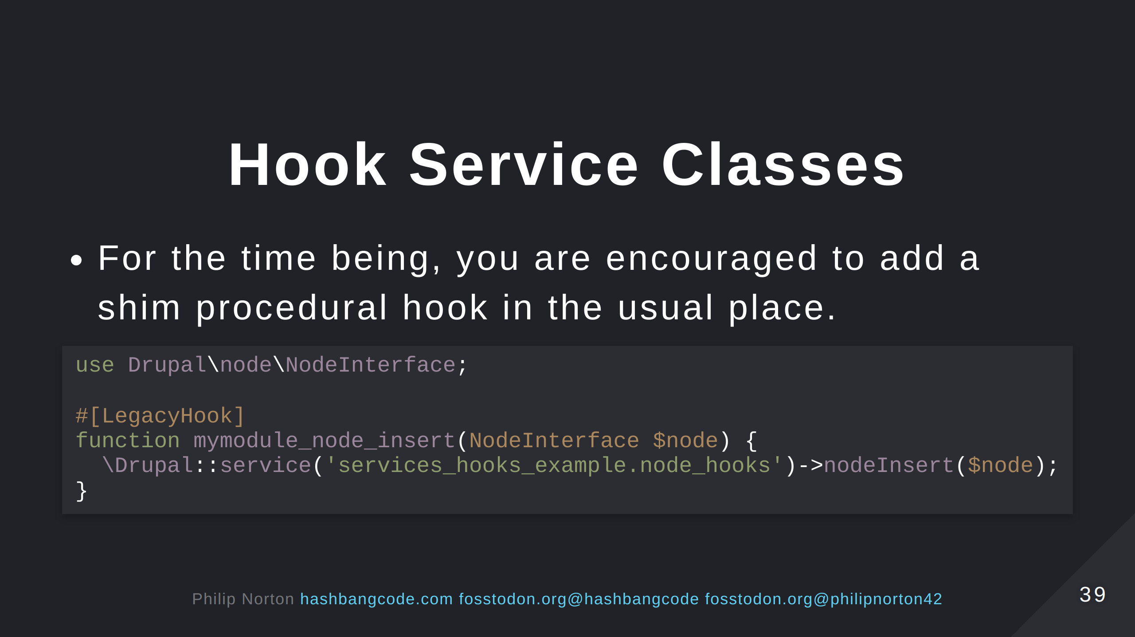
Notes:
There doesn't appear to be any word on deprications of procedural hooks. In fact many theme and install hooks will remain. The aim is to allow low level hooks that have no dependencies to operate as they always have.

Slide 40
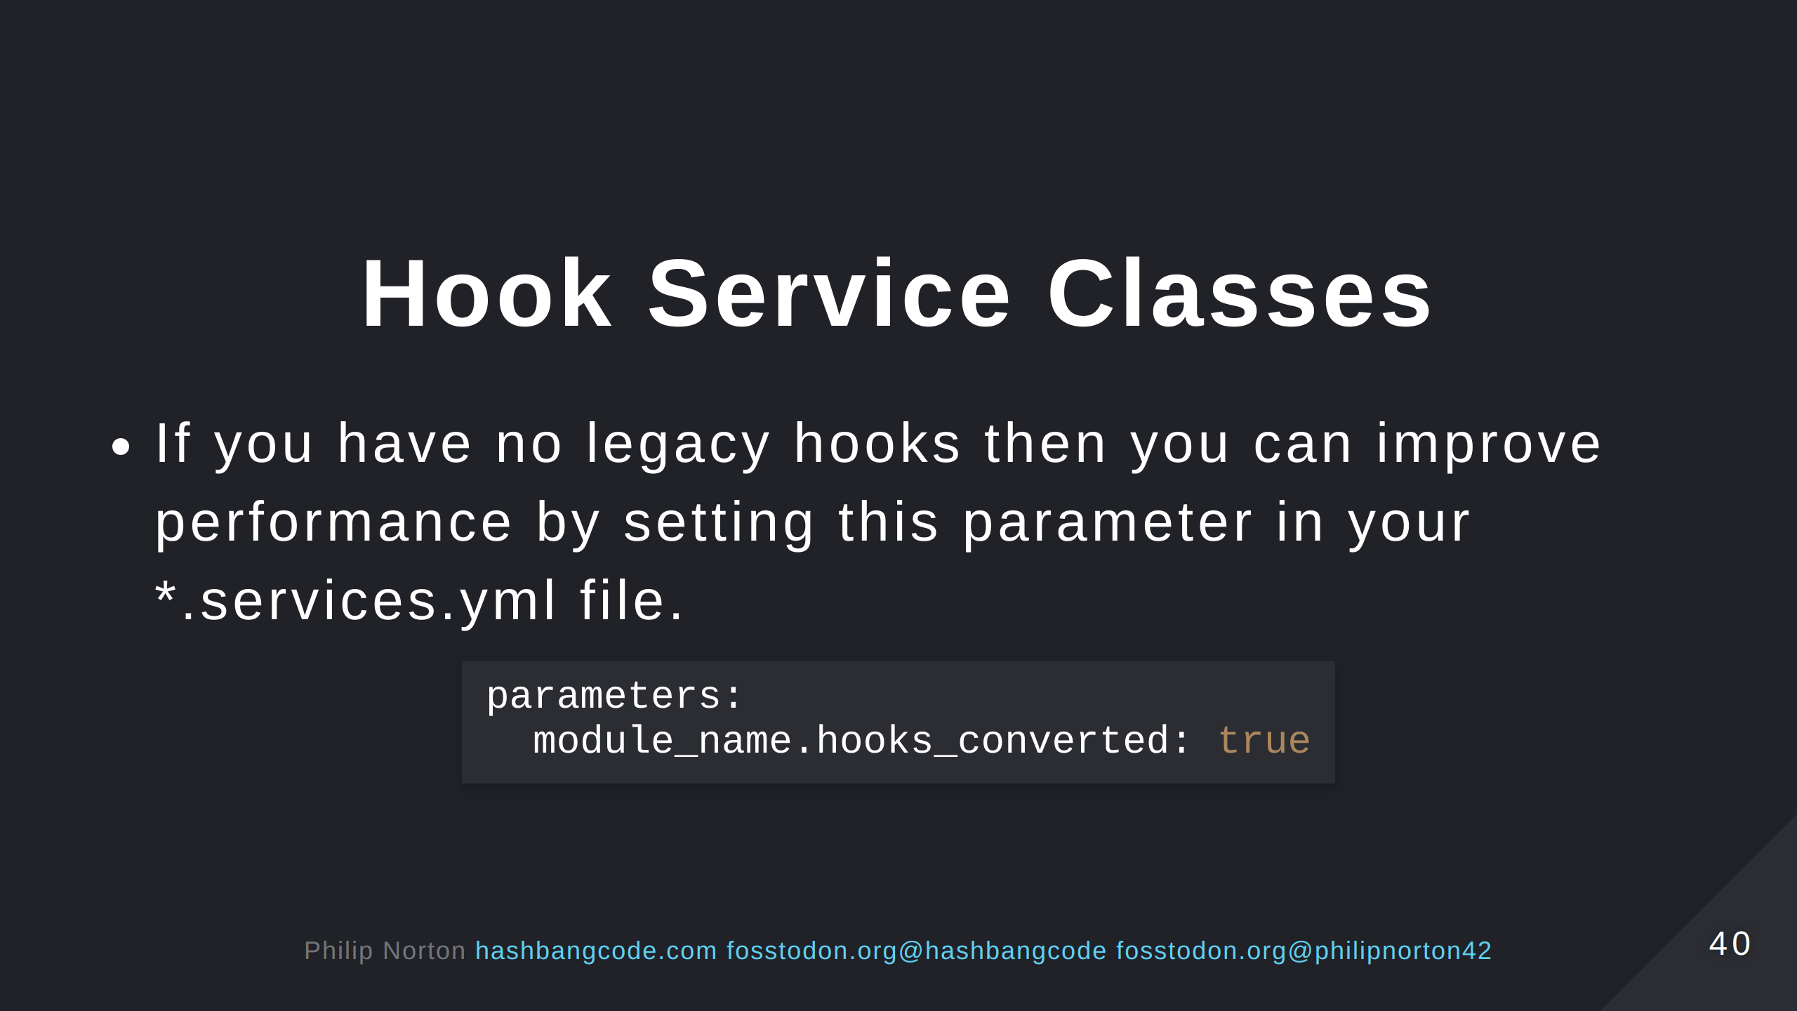

Slide 41
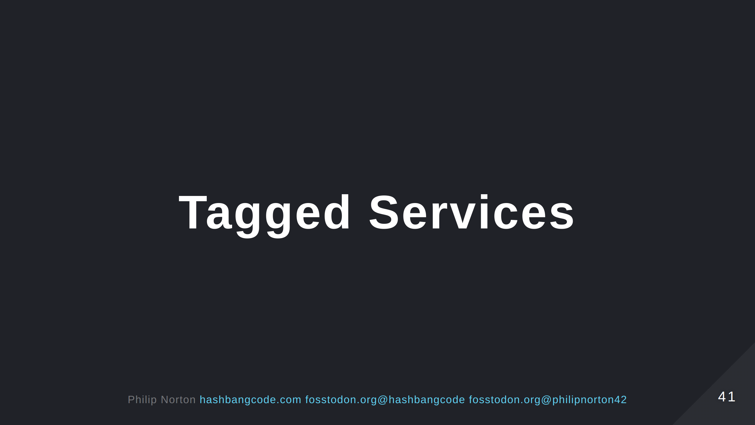

Slide 42
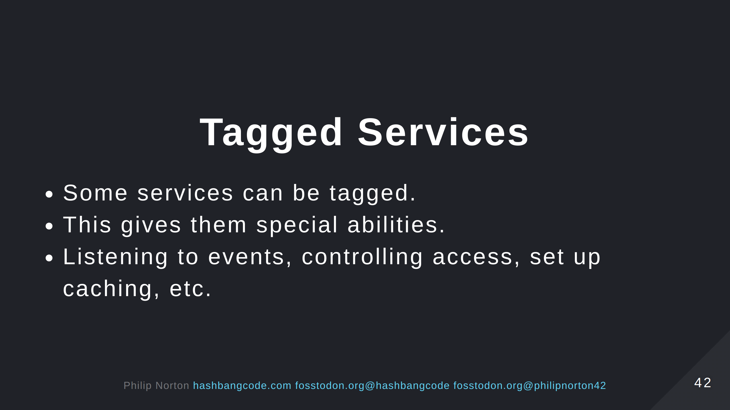

Slide 43
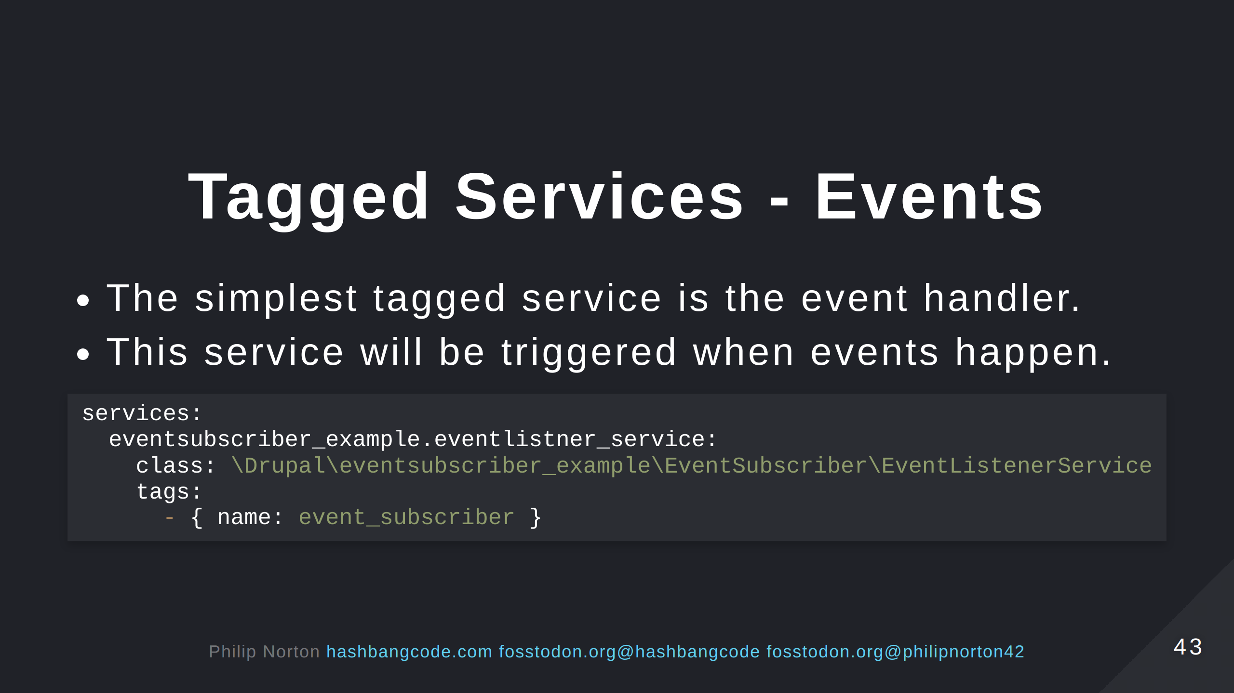

Slide 44
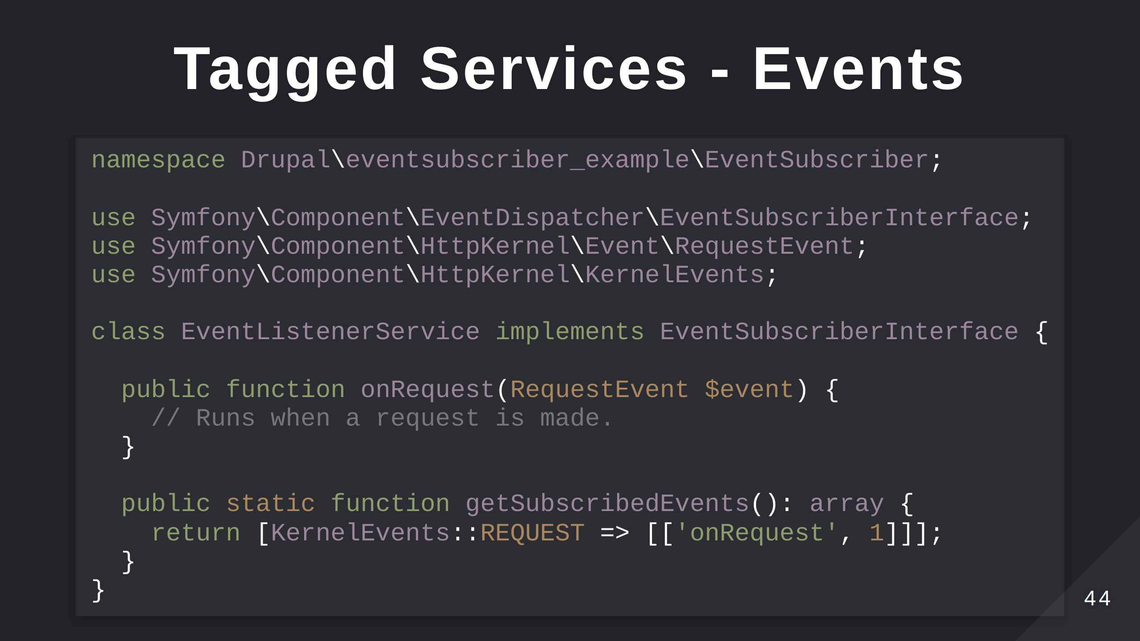

Slide 45
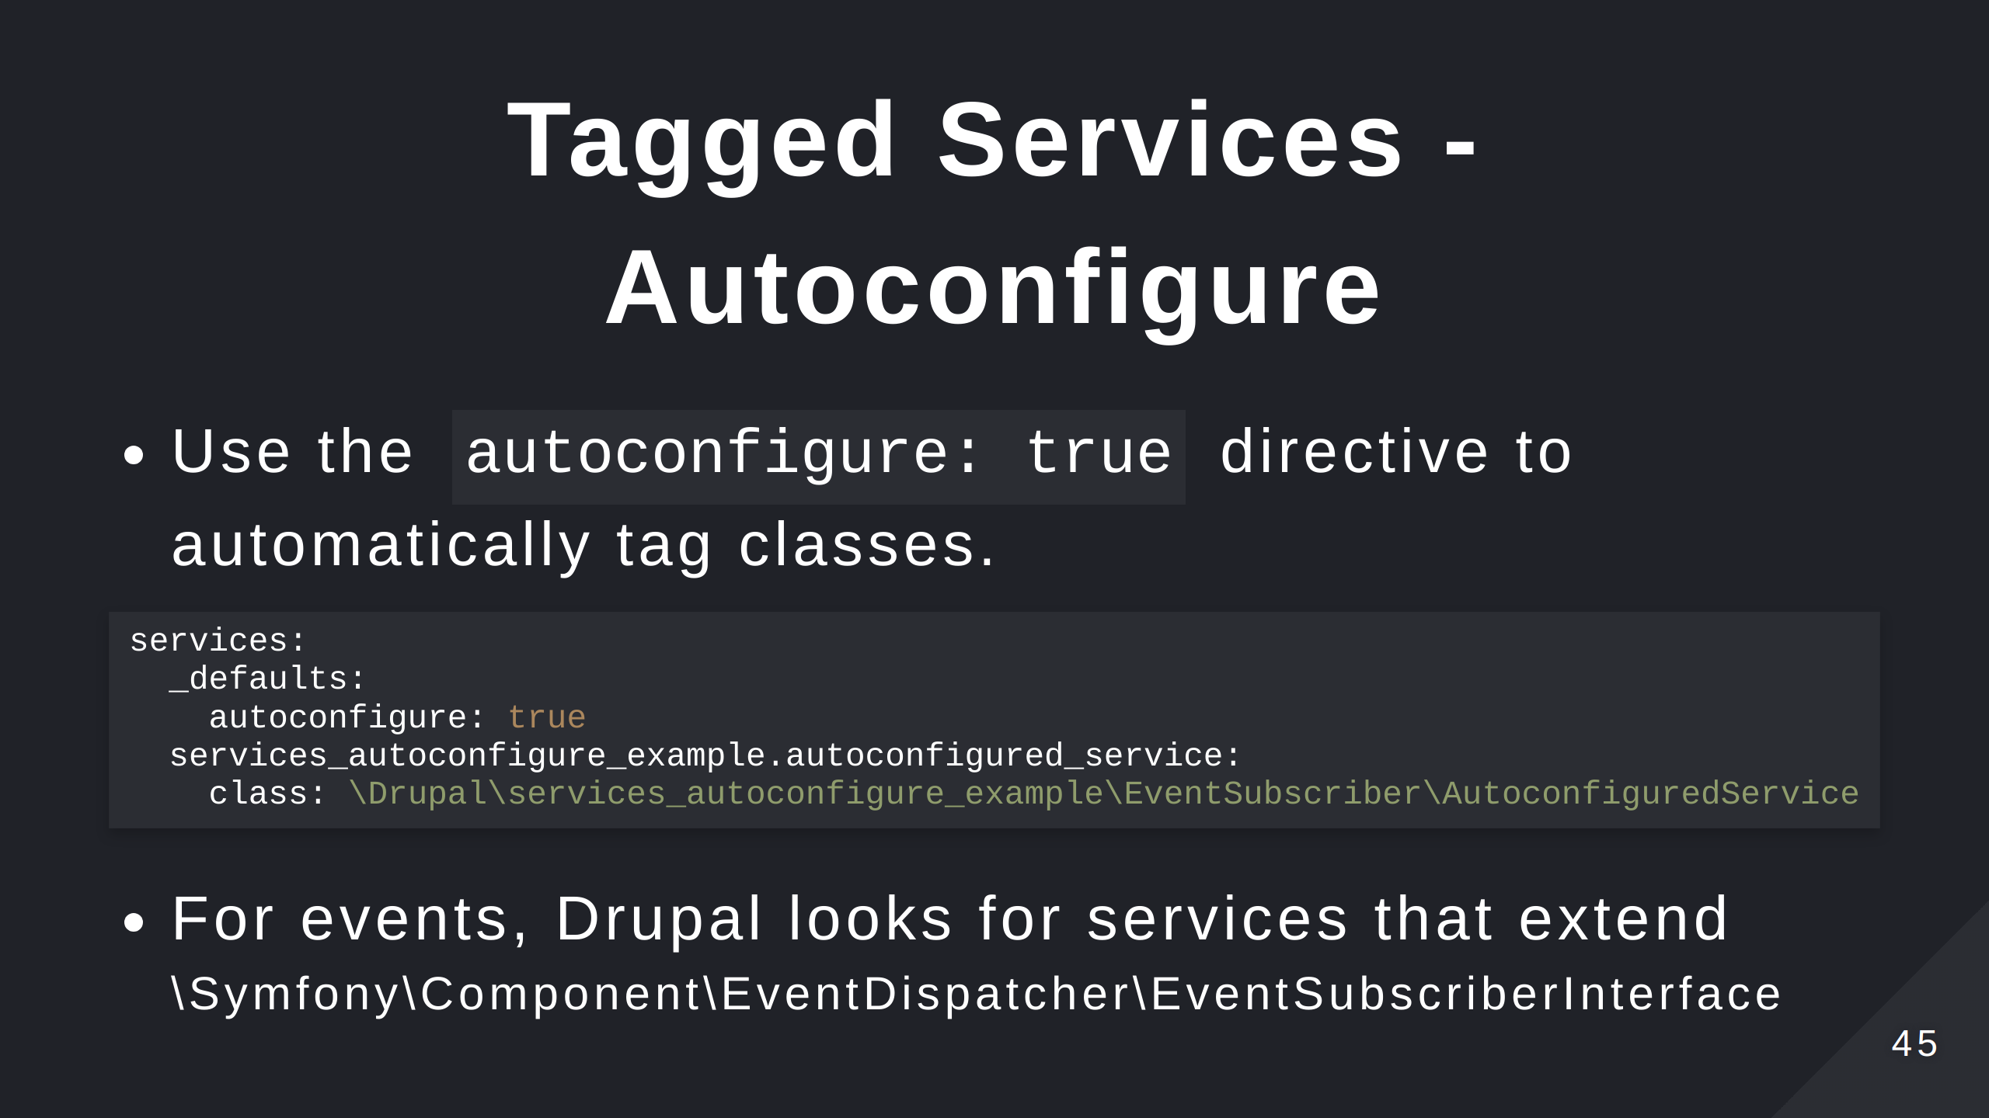

Slide 46


Slide 47
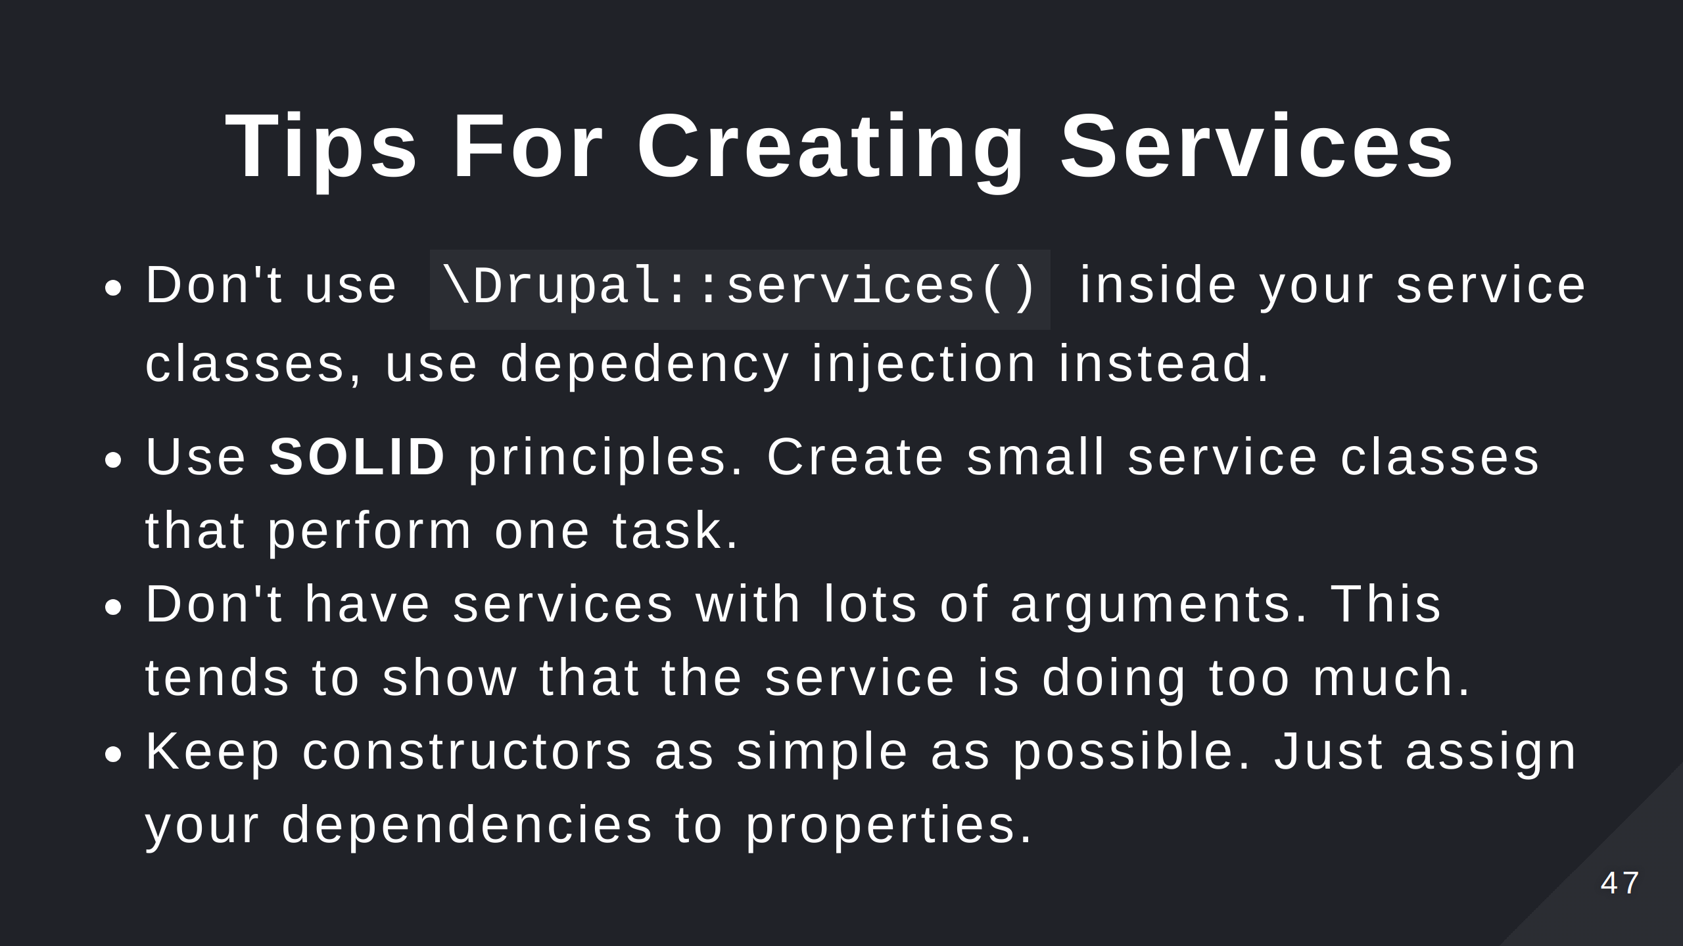

Slide 48
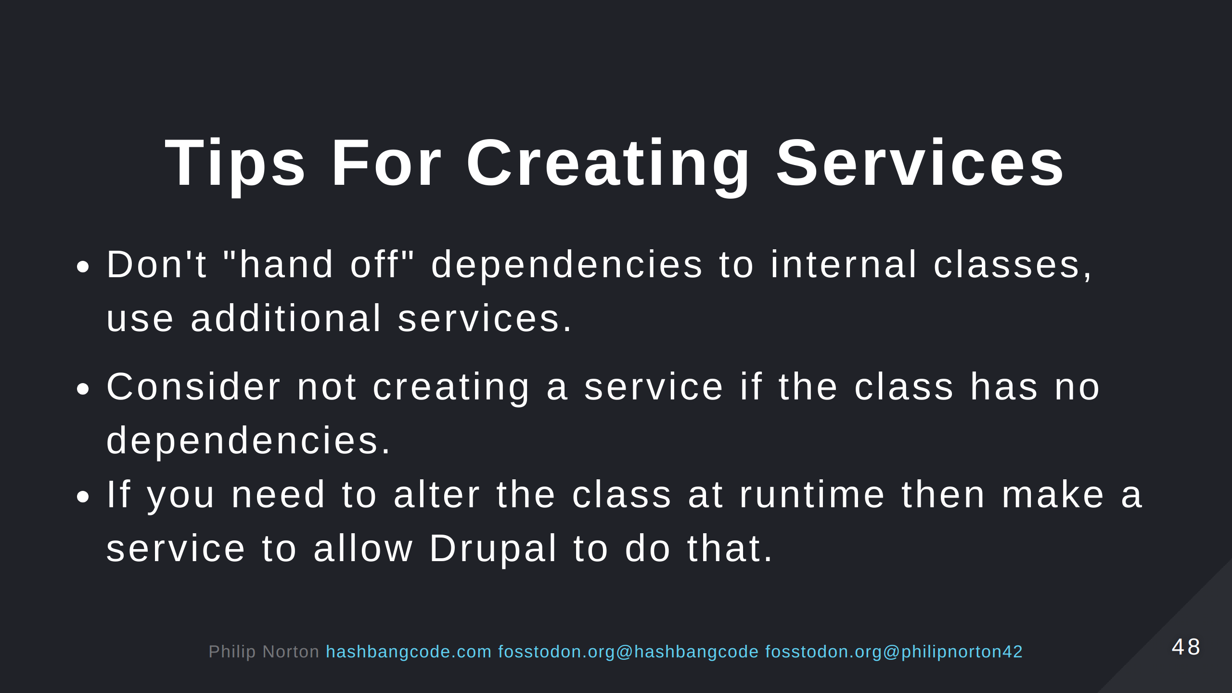

Slide 49
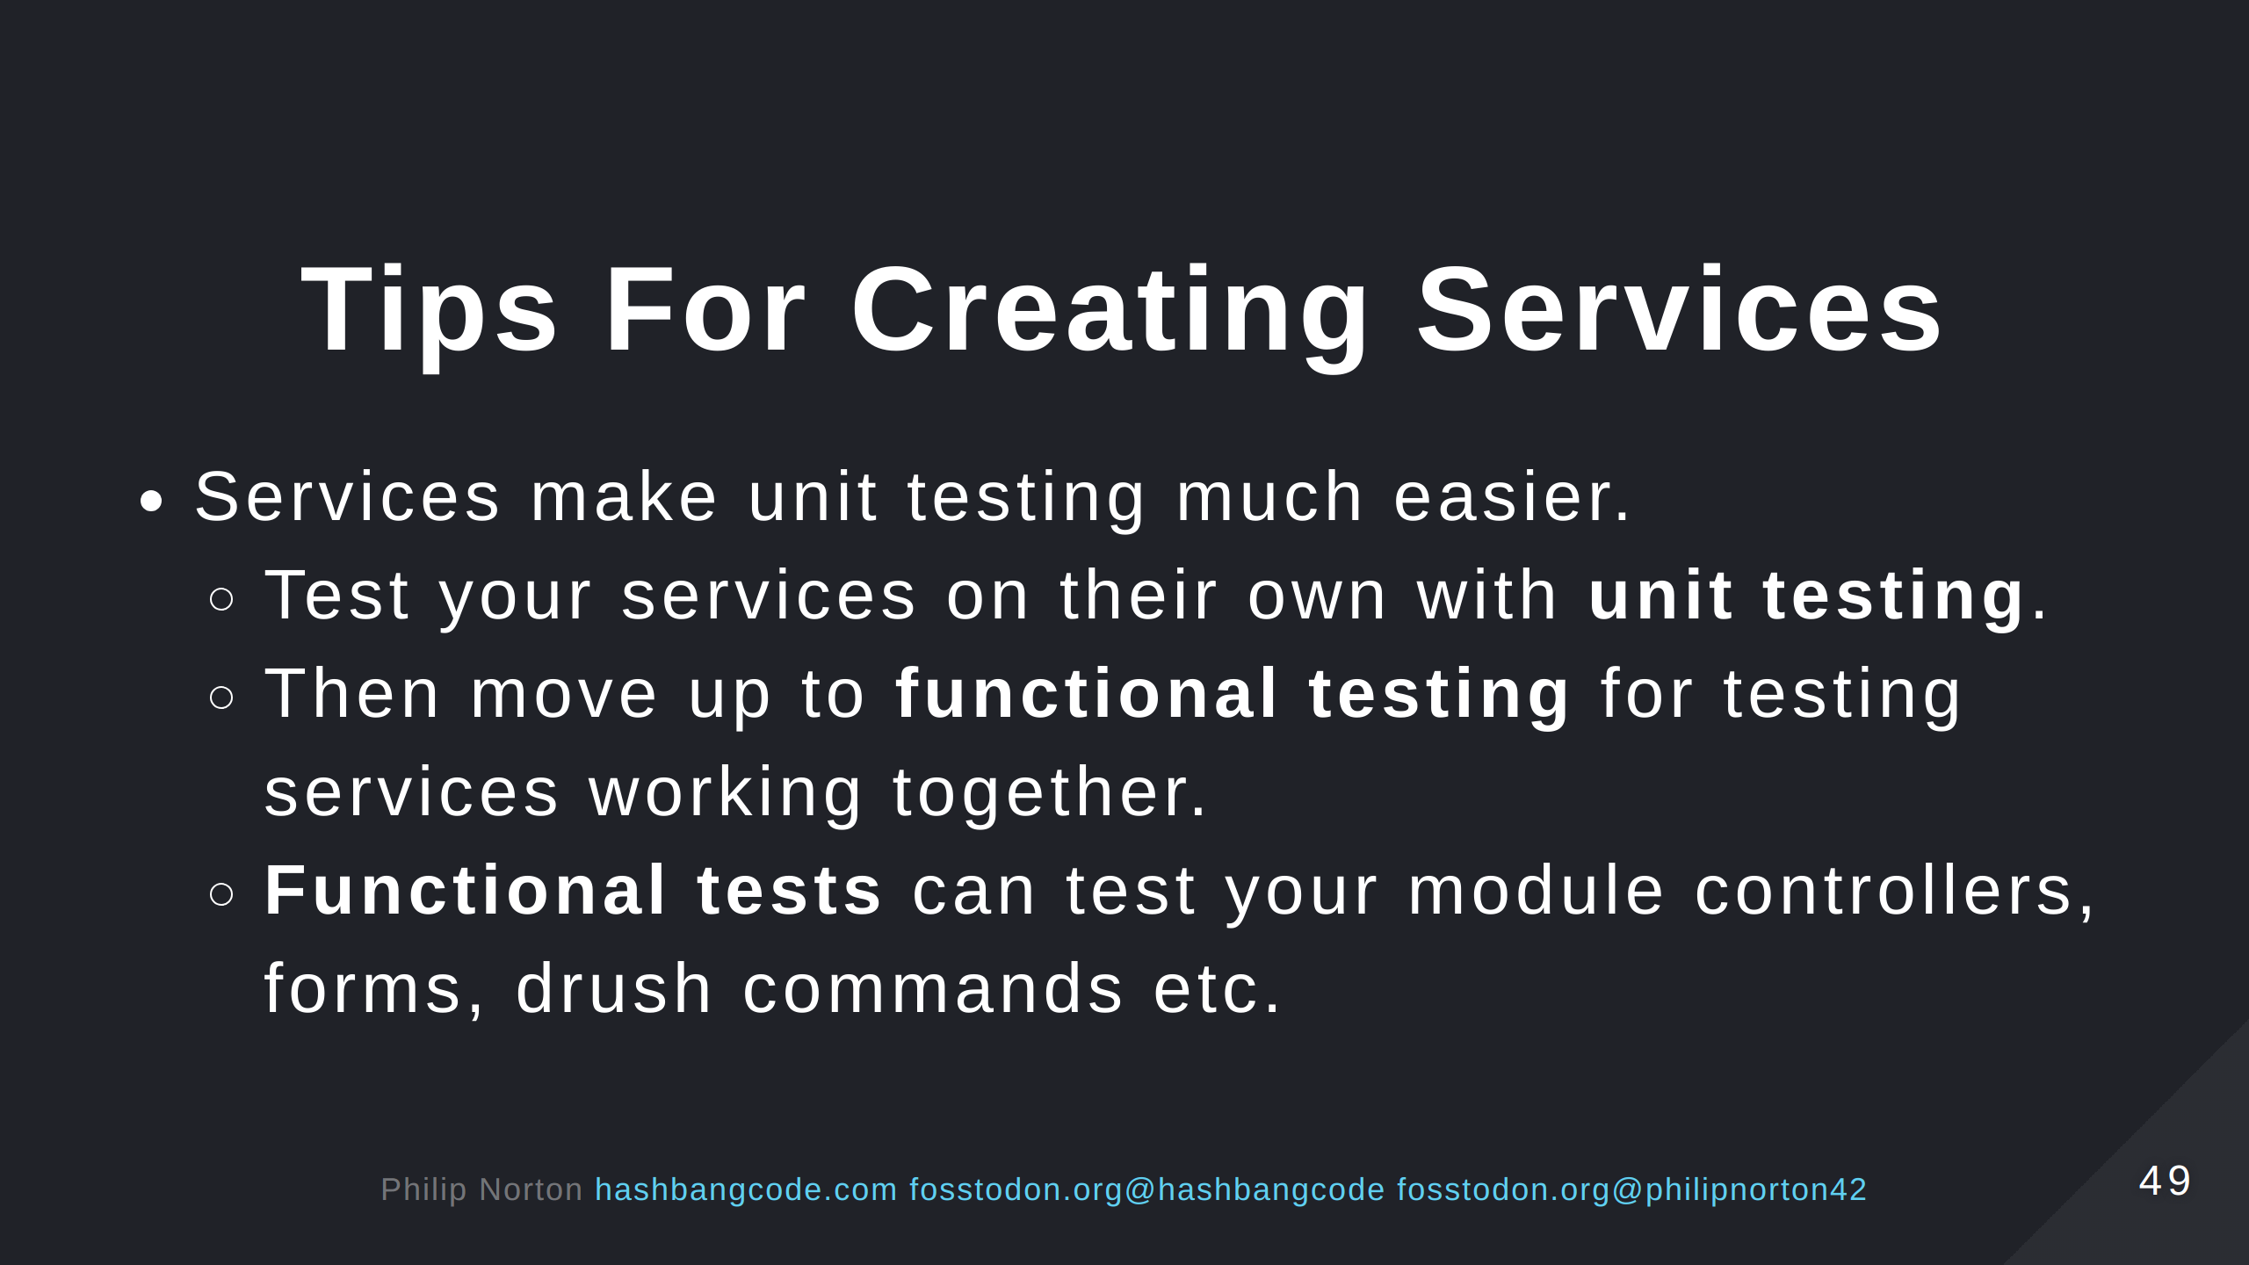

Slide 50
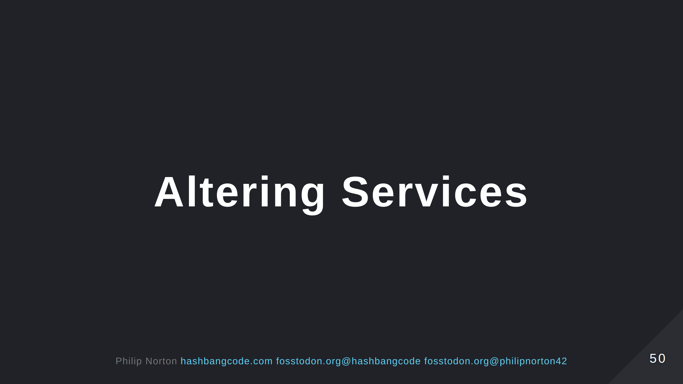

Slide 51
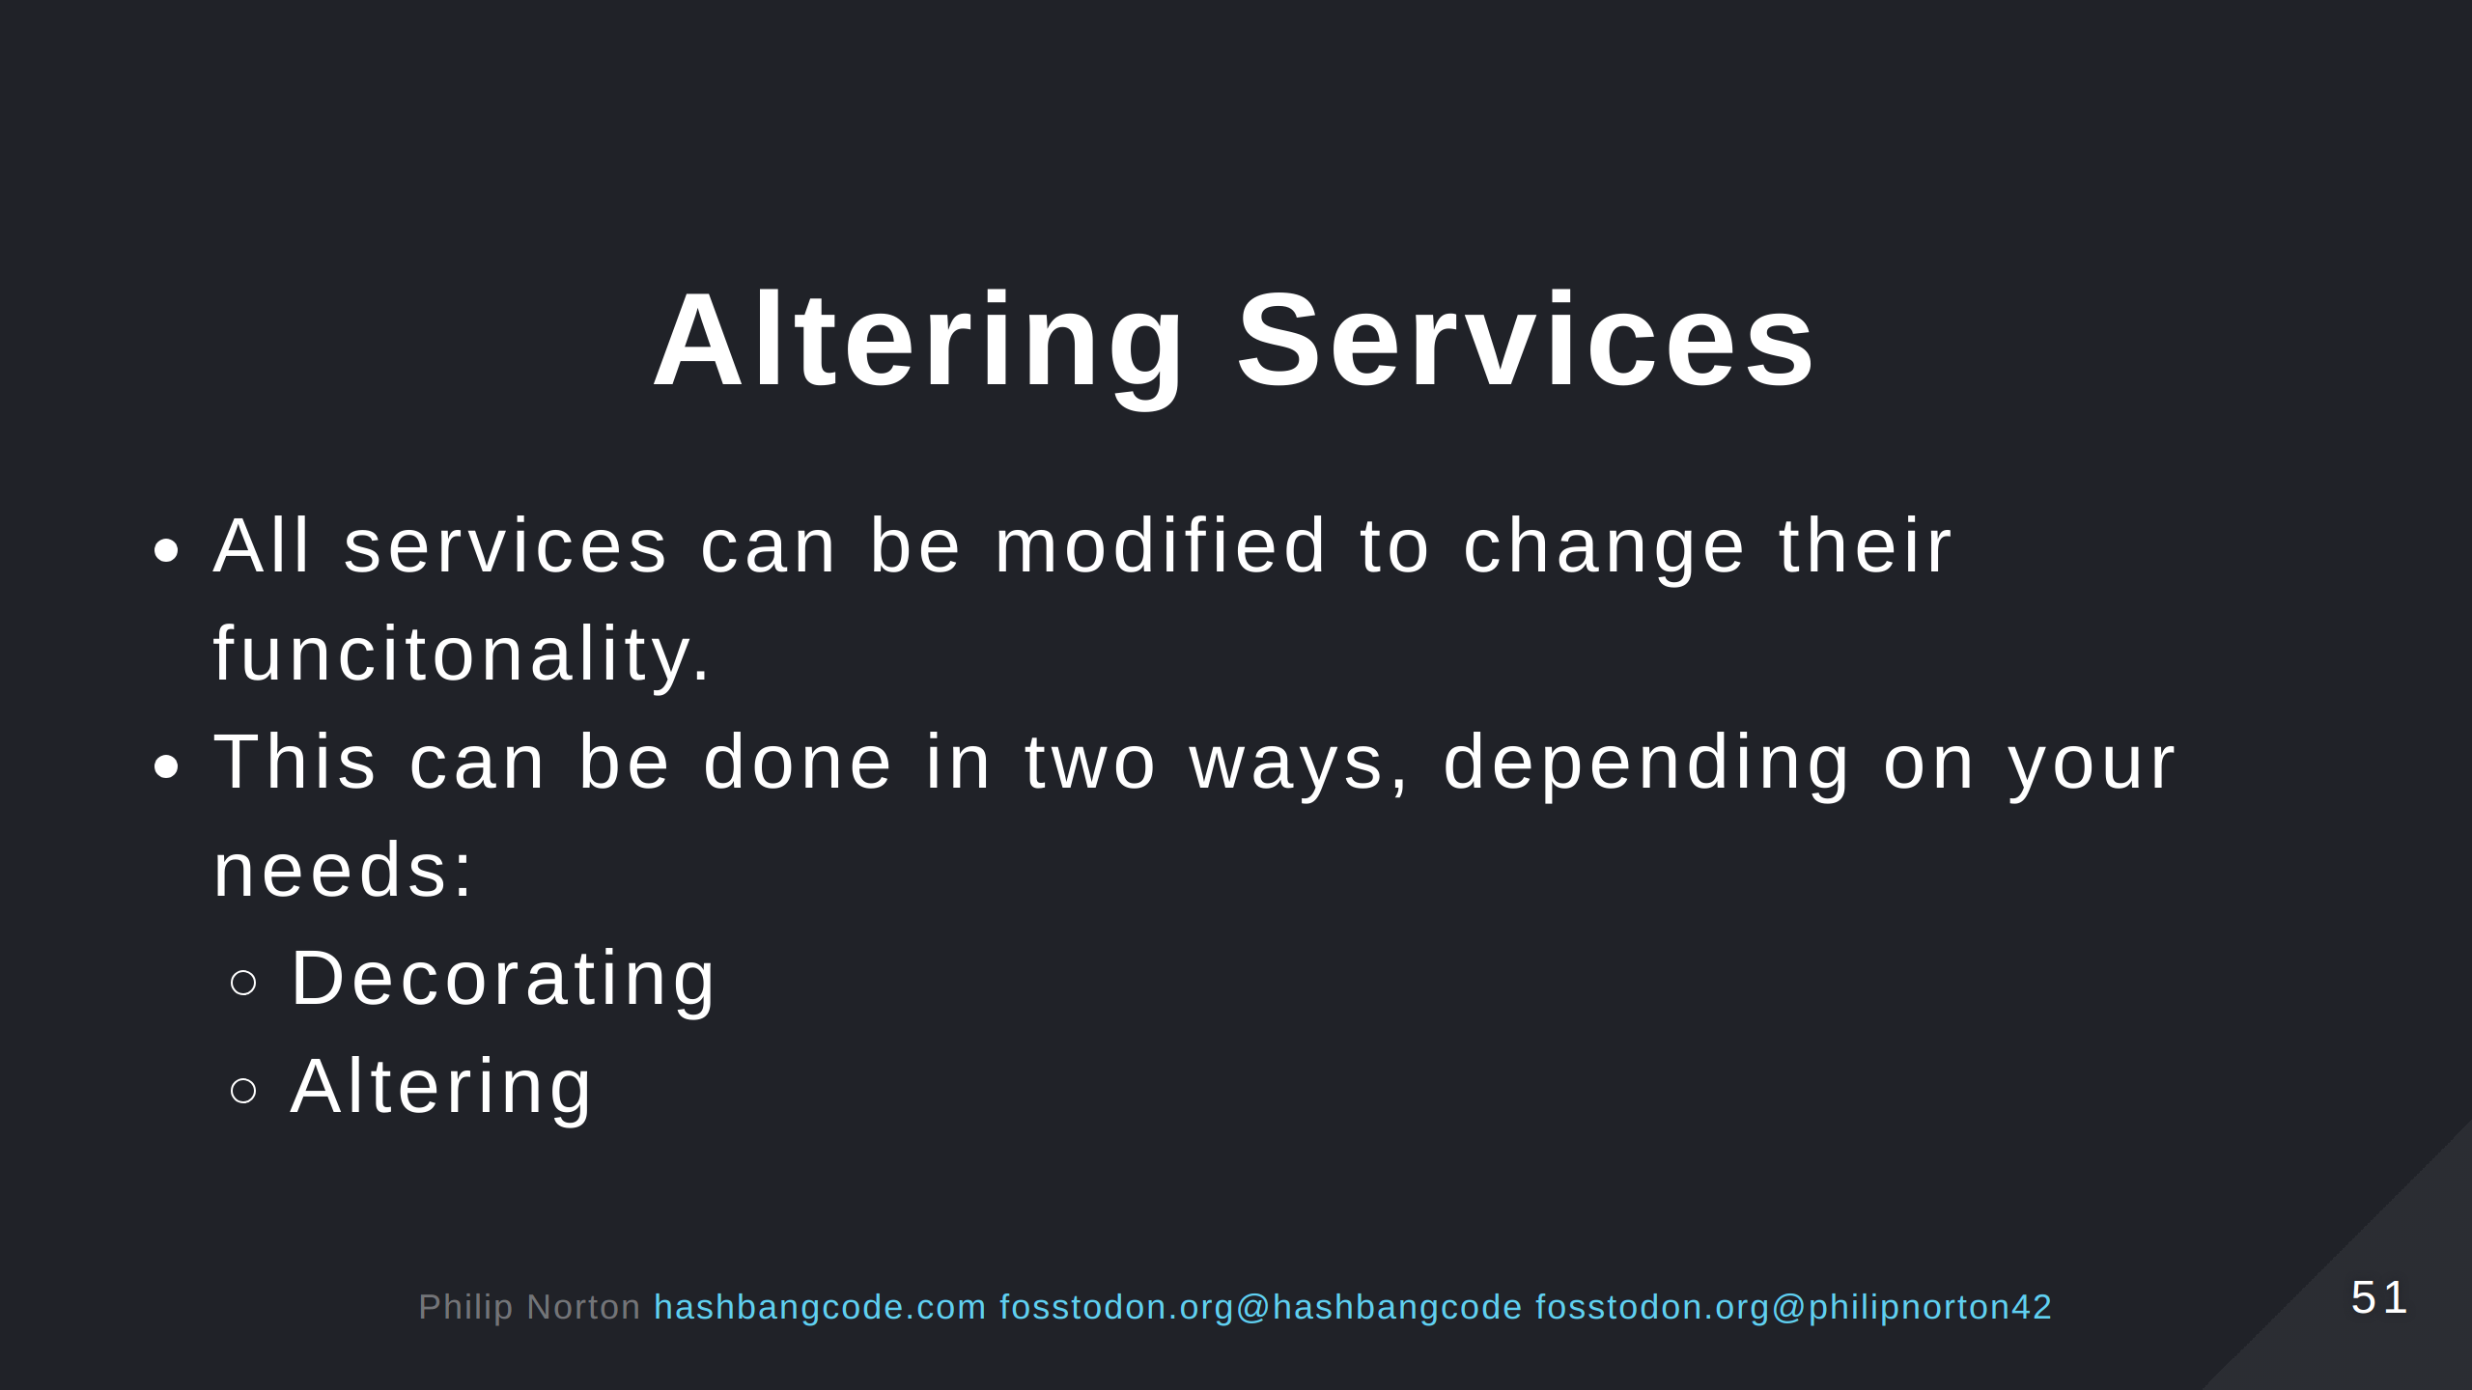

Slide 52
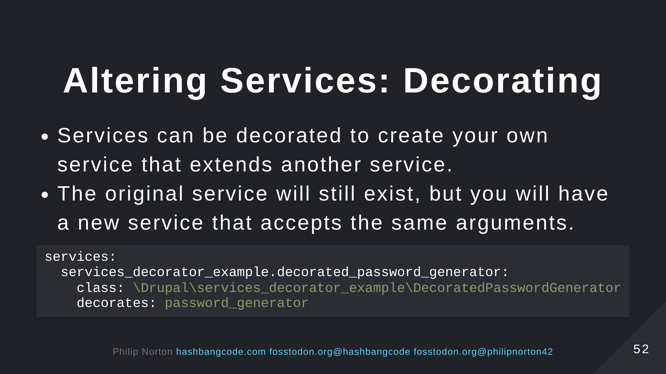
Notes:
Here, we are decorating the password_generator and creating our own service called services_decorator_example.decorated_password_generator. The critical thing is that the existing service class still exists. The new service just extends that.

Slide 53
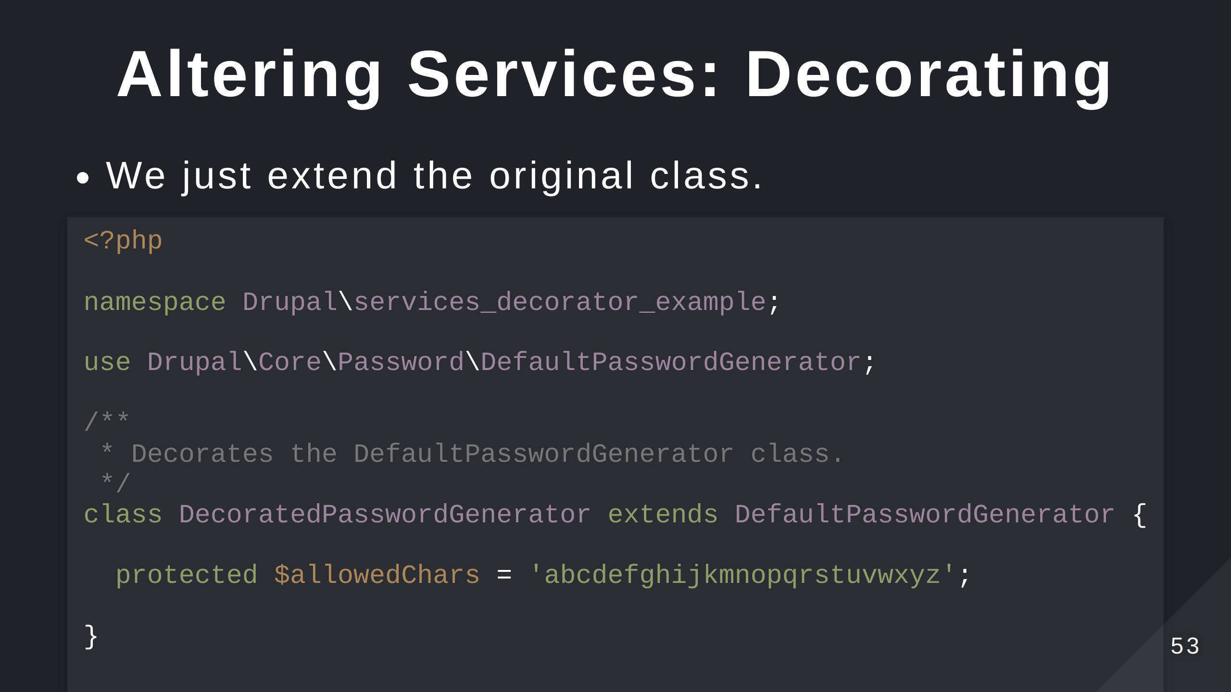

Slide 54
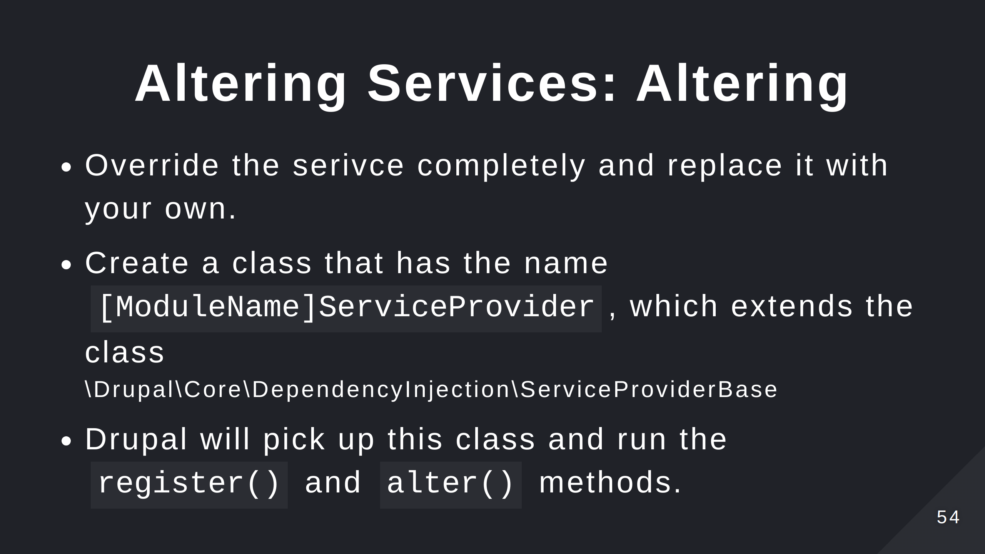
Notes:
Use register() to register a new service in Drupal. Useful for highly dynamic services where you want to automatically create your services at run time. Use alter() to alter the service registry and change any registered service in the site.

Slide 55


Slide 56


Slide 57


Slide 58


Slide 59

Notes:
Here, we are altering the joke_api.joke service to replace it with our a stub service that doesn't integrate with the Joke API.

Slide 60


Slide 61


Slide 62


Slide 63

Notes:
- These links are on the repo page for the talk. https://github.com/hashbangcode/drupal-services-talk.

Slide 64


Slide 65


Slide 66


